Slide 1

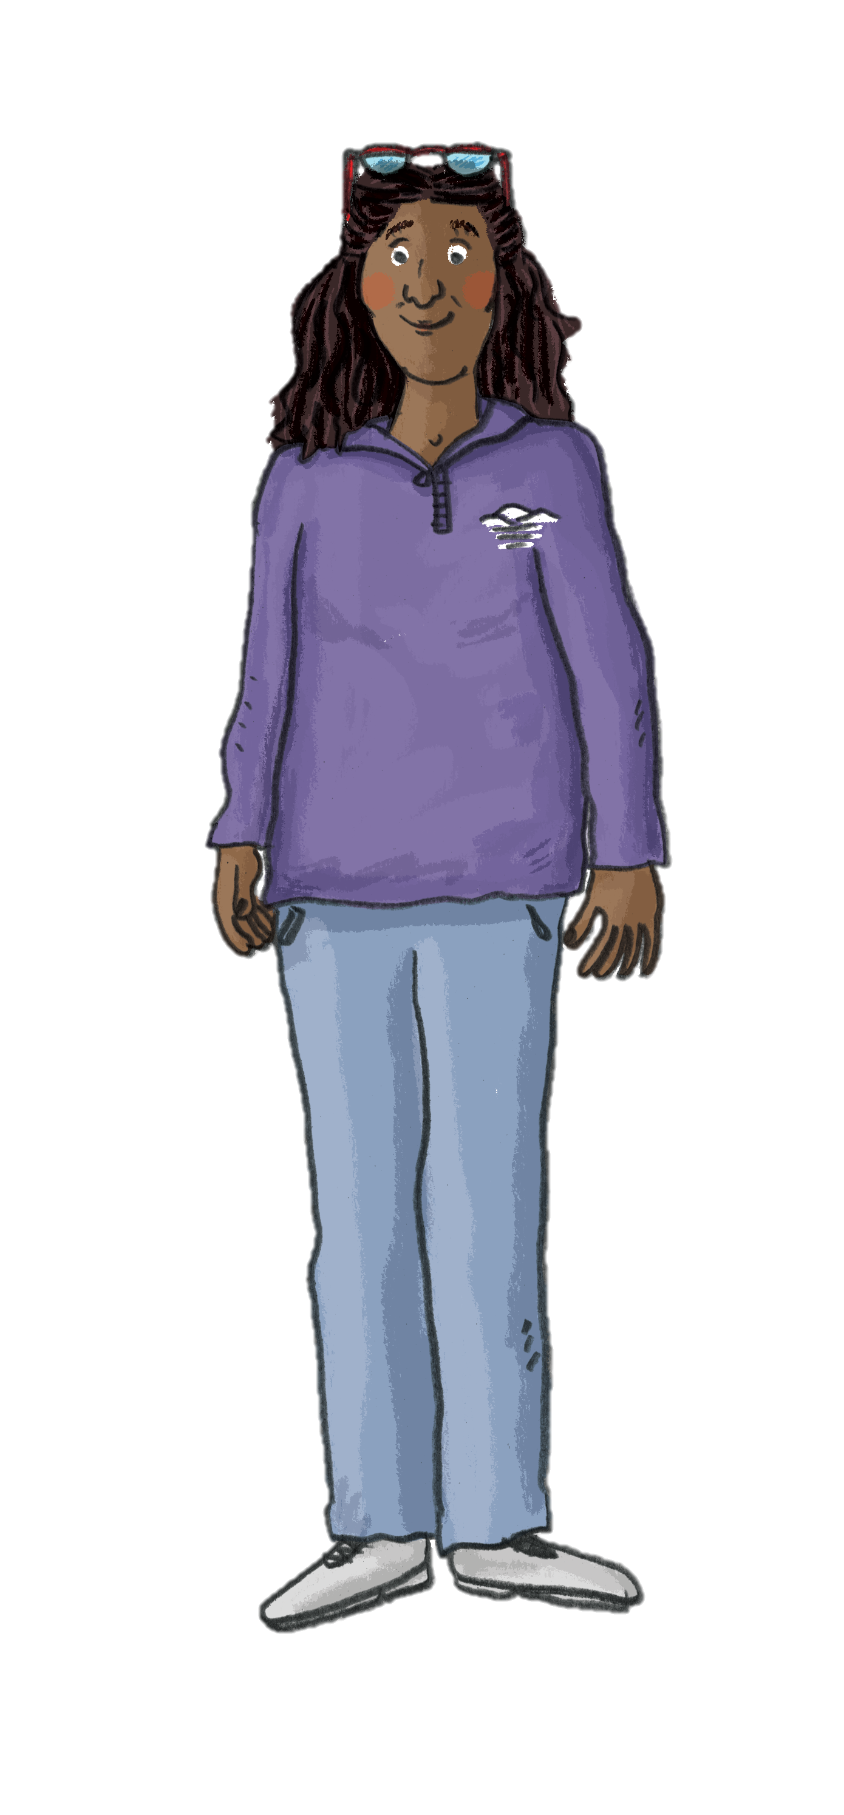
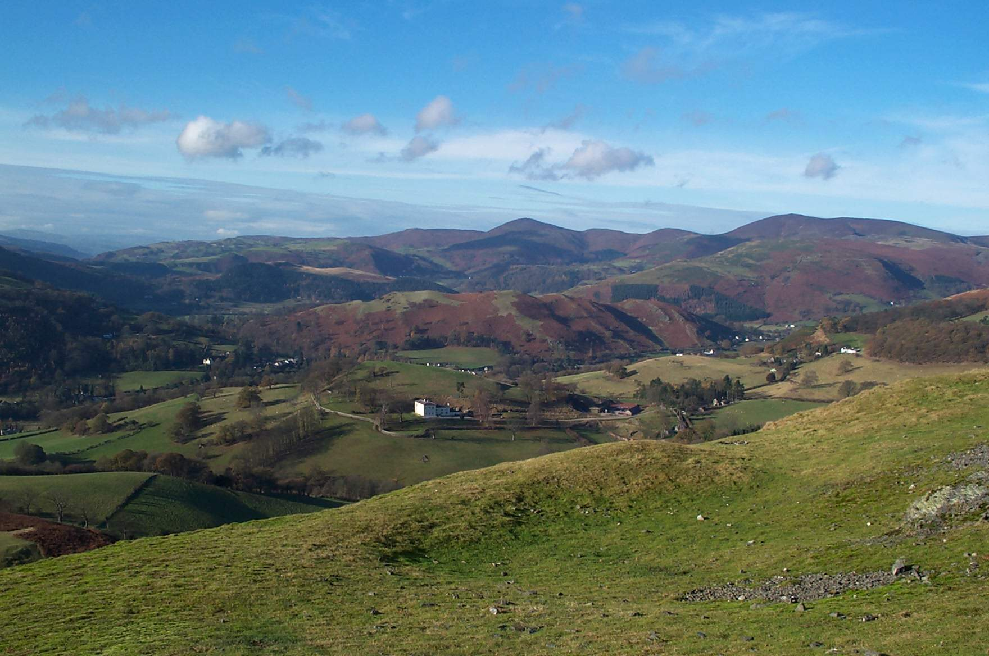


Our Special
National Landscape
Did you know that areas of our landscape are so important that they are protected?

Slide 2
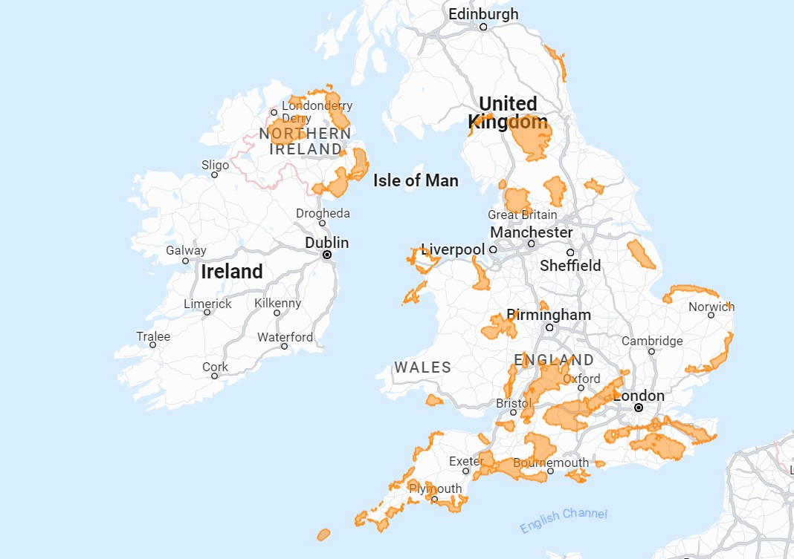
What is a National Landscape?
Can you locate the Clwydian Range and Dee Valley National Landscape on the map?
Can you name any other National Landscapes?
A National Landscape is an important area because of its Outstanding Natural Beauty.
These landscapes are unique in their character, beauty, and cultural heritage and are so precious that they are safeguarded. This means the natural beauty, communities, businesses, unique architecture and archaeology of the area are protected.
On the map you can see the UK’s 46 National Landscapes. Altogether they protect more land than the more famous 15 UK National Parks.
Can you name any National Parks?

Slide 3
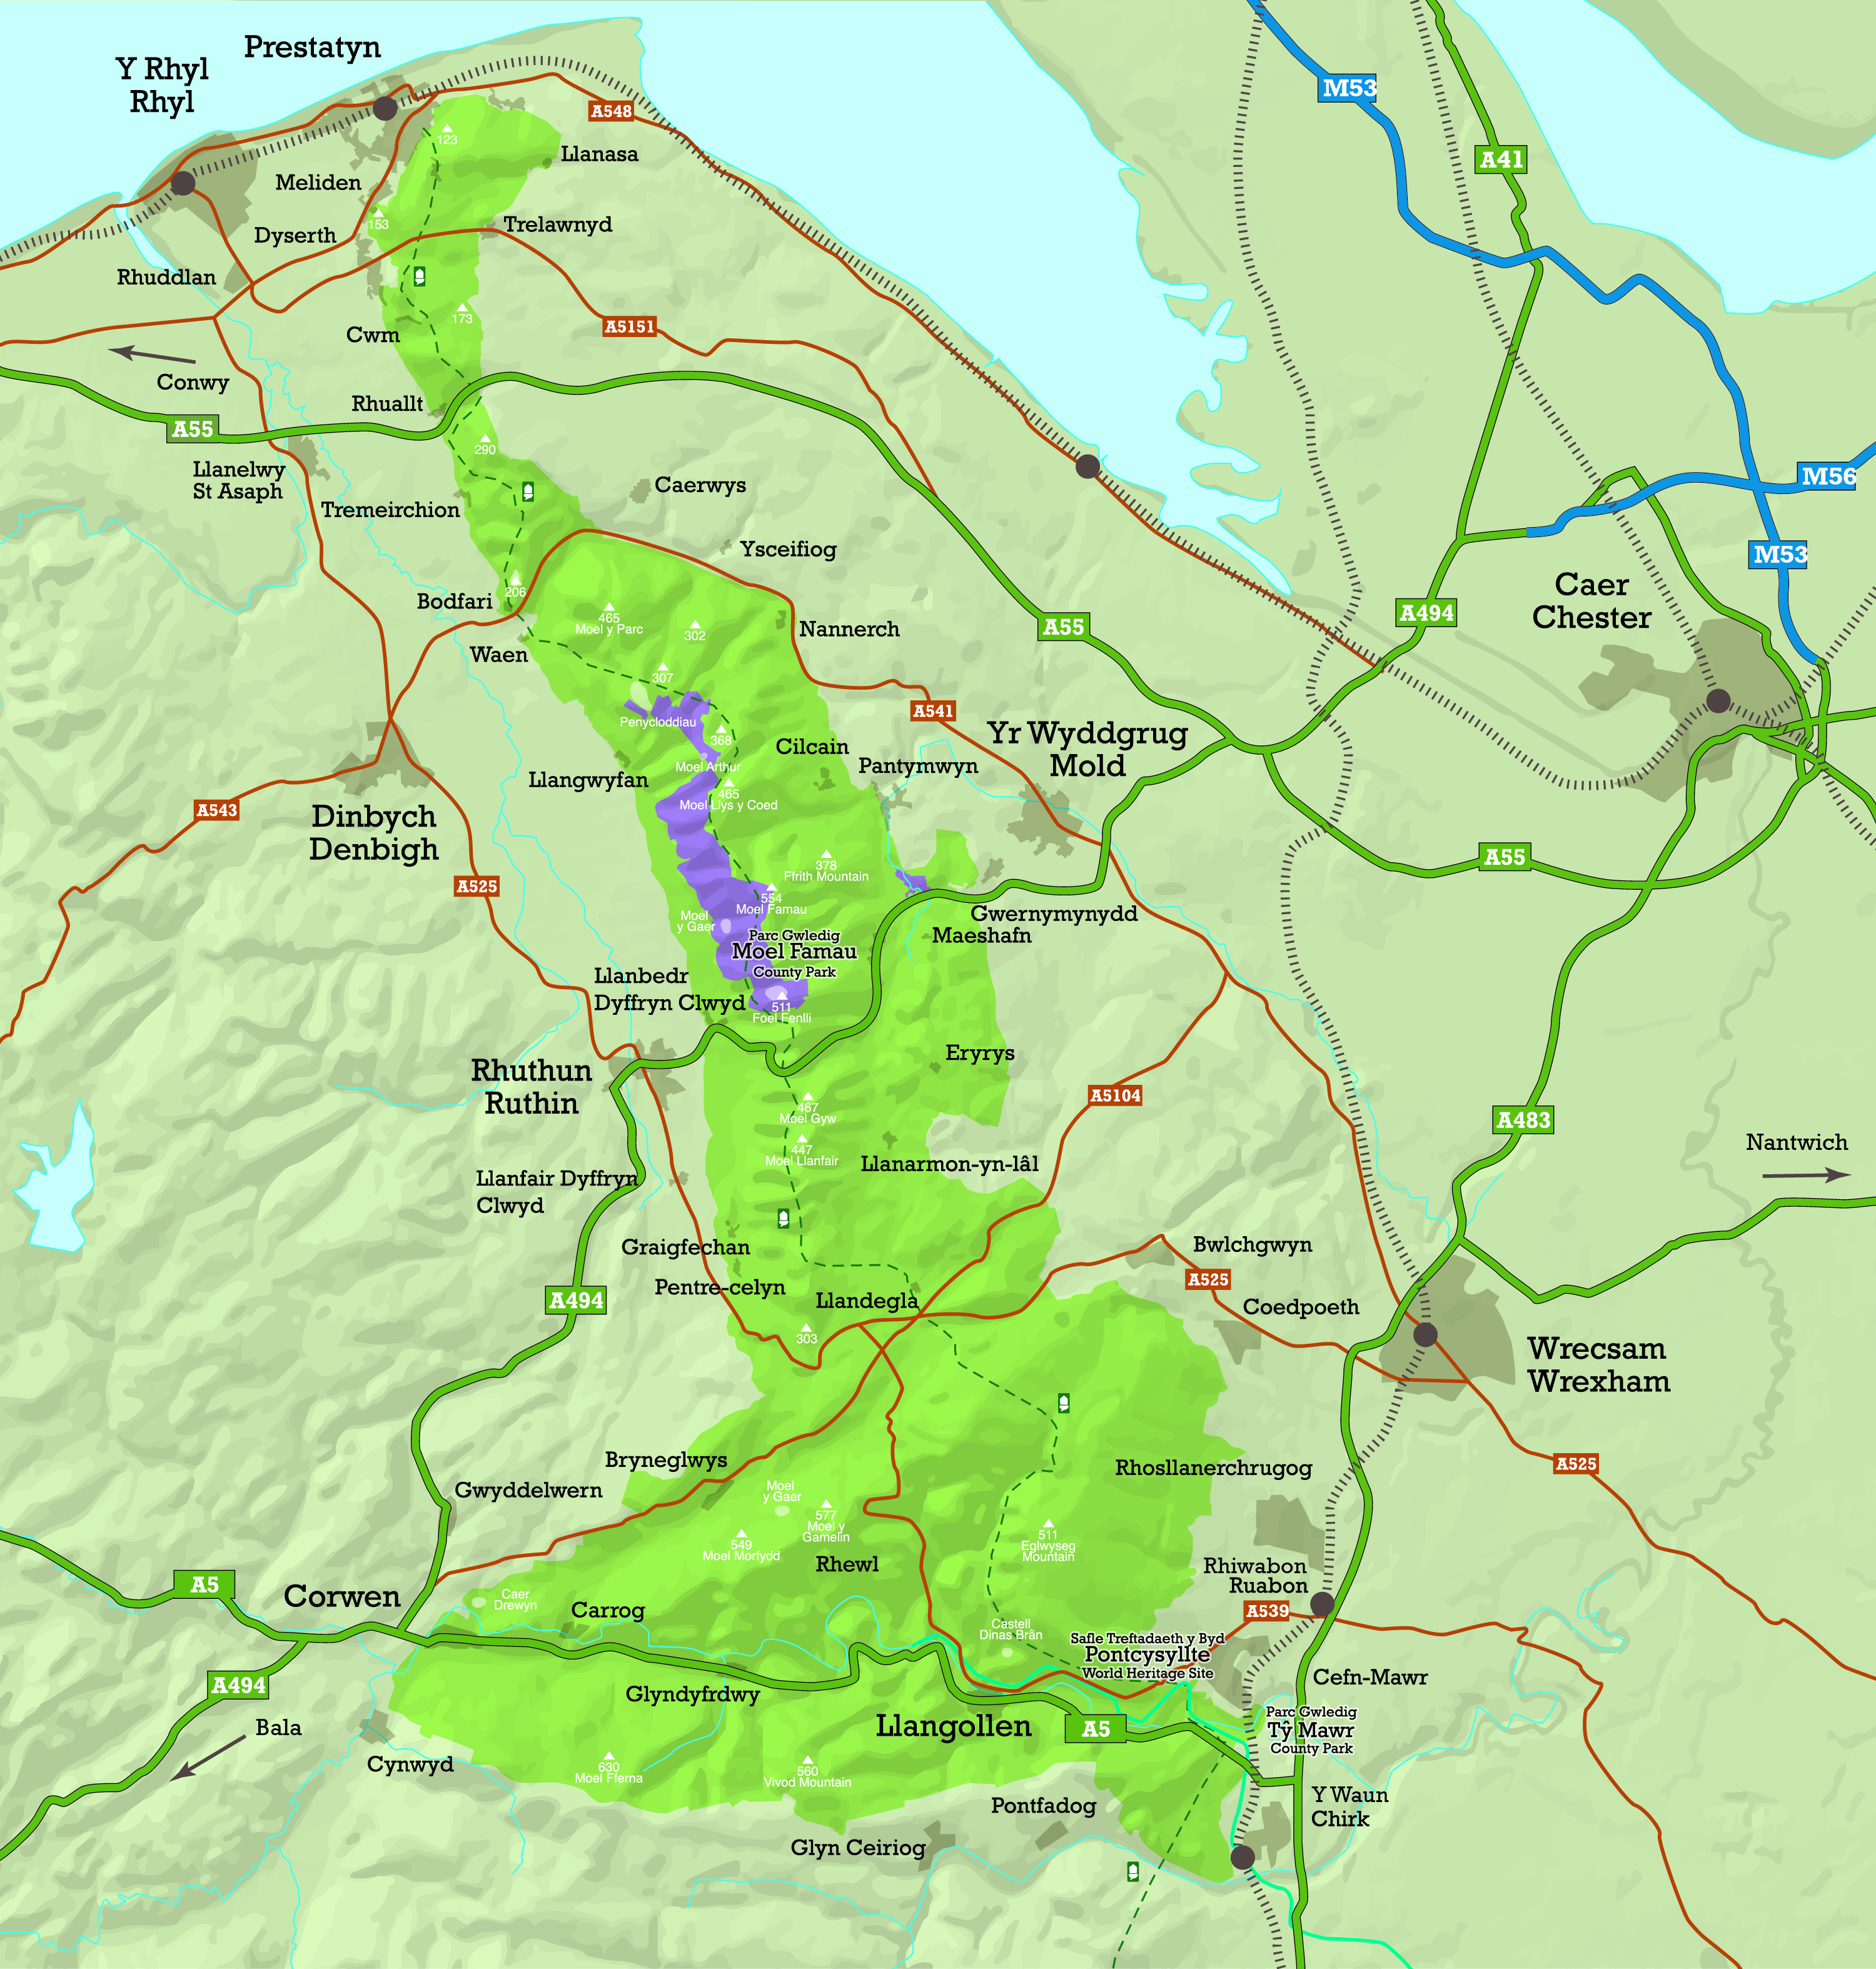
Our National Landscape
Are there any special places on the map that you would like to visit or that you would like to take a friend to explore?
The Clwydian Range and Dee Valley covers 390 square kilometres, from the coastal slopes of Prestatyn Hillside in the North to the remote Berwyn Mountains and the Pontcysyllte Aqueduct and Canal in the South.
The Clwydian Range is a remarkable chain of
heather-clad peaks crowned with Iron Age hillforts. The rolling Llandegla moors give way to the vast Ruabon Mountain and the spectacular limestone of the Eglwyseg cliffs.
The Dee Valley is rich in heritage, with the picturesque remains of Castell Dinas Bran, Eliseg’s Pillar and Valle Crucis Abbey and the mighty Chirk Castle. The Pontcysyllte Aqueduct and Canal, designated a World Heritage Site, is a monument to the National Landscape’s industrial past.

Slide 4
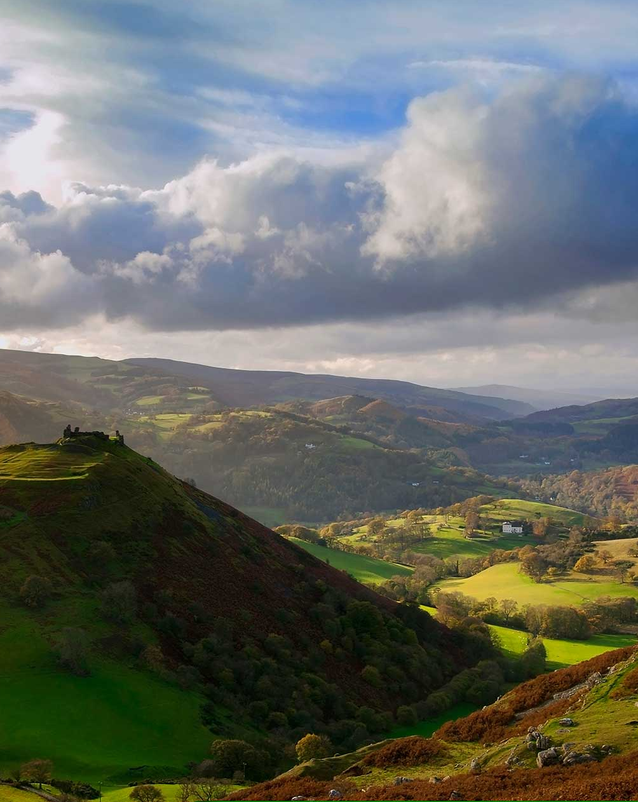
Special qualities
The landscapes of the Clwydian Range and Dee Valley are unique in character and different from other areas.
Why is it special to you?
Perhaps it’s the tranquillity of the remote and untouched wilderness, or the astounding views that can be seen from the many summits. Maybe it’s the ancient history, the remains of which can be glimpsed in the archaeology, ruins and architecture. Or is it the wealth of wildlife that you can find in natural habitats that draws you to visit?
Take a moment to reflect on why you love
the landscape in this area, then have a look through the following images, do you recognise some of the places?

Slide 5
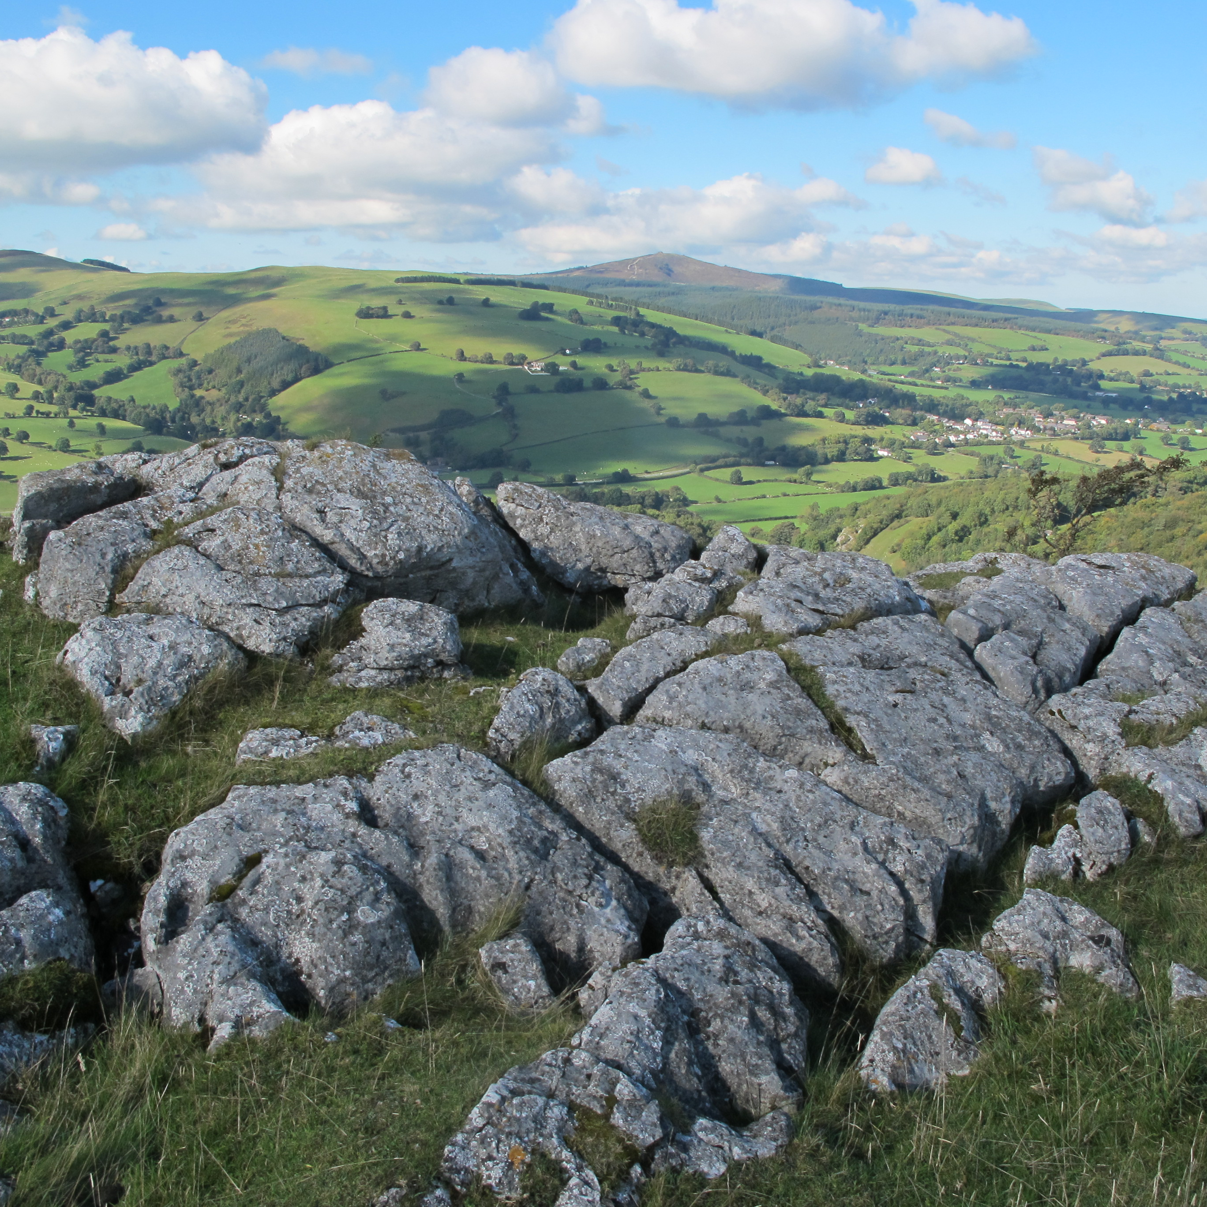
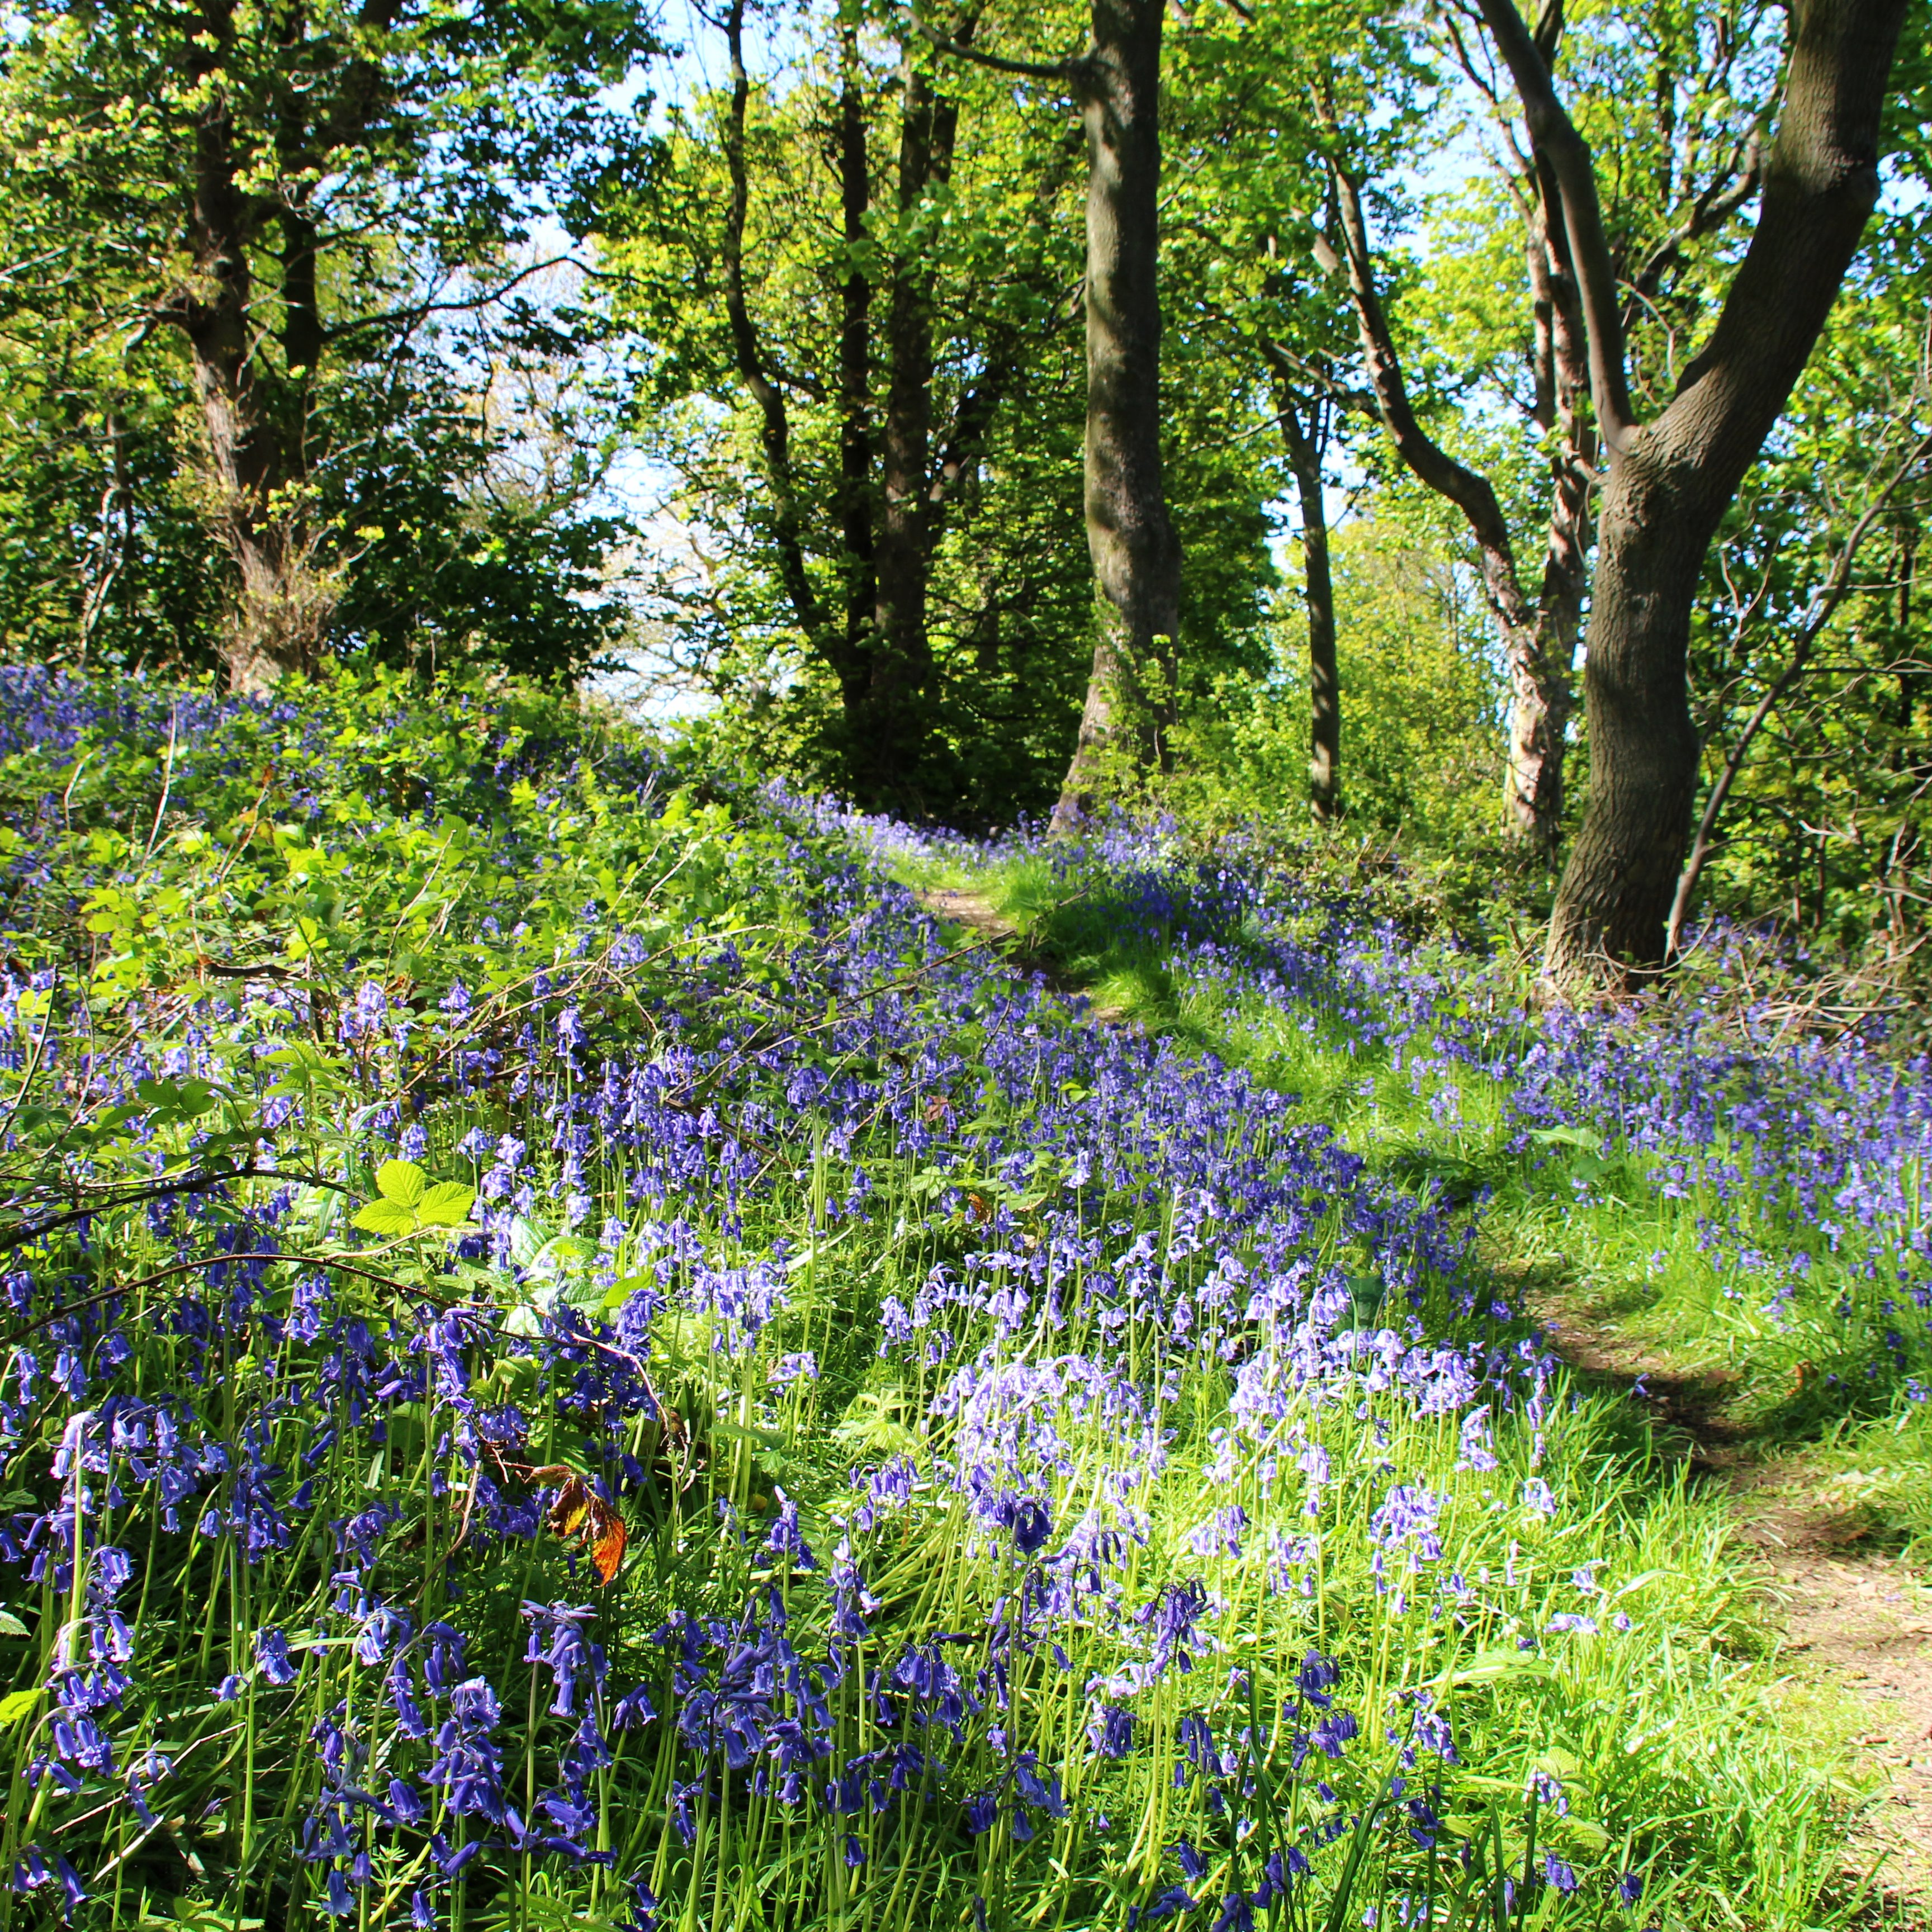

Slide 6
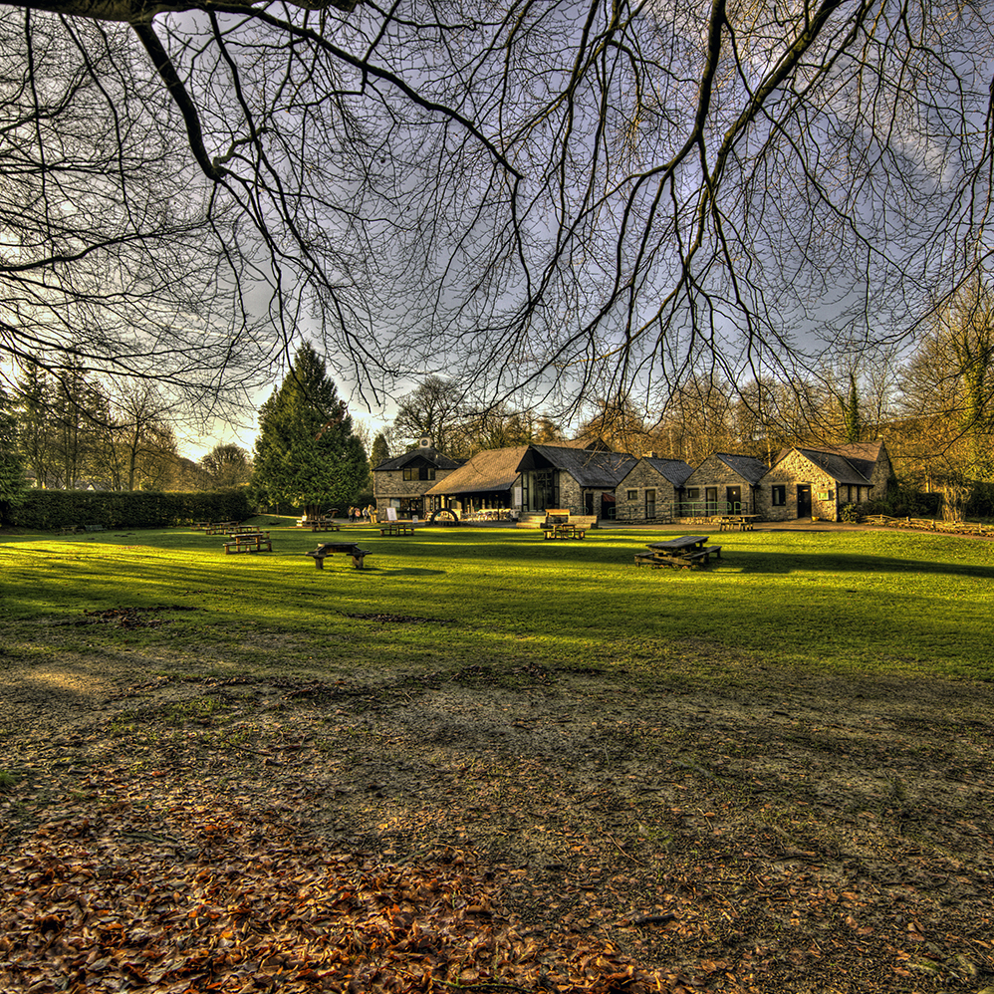
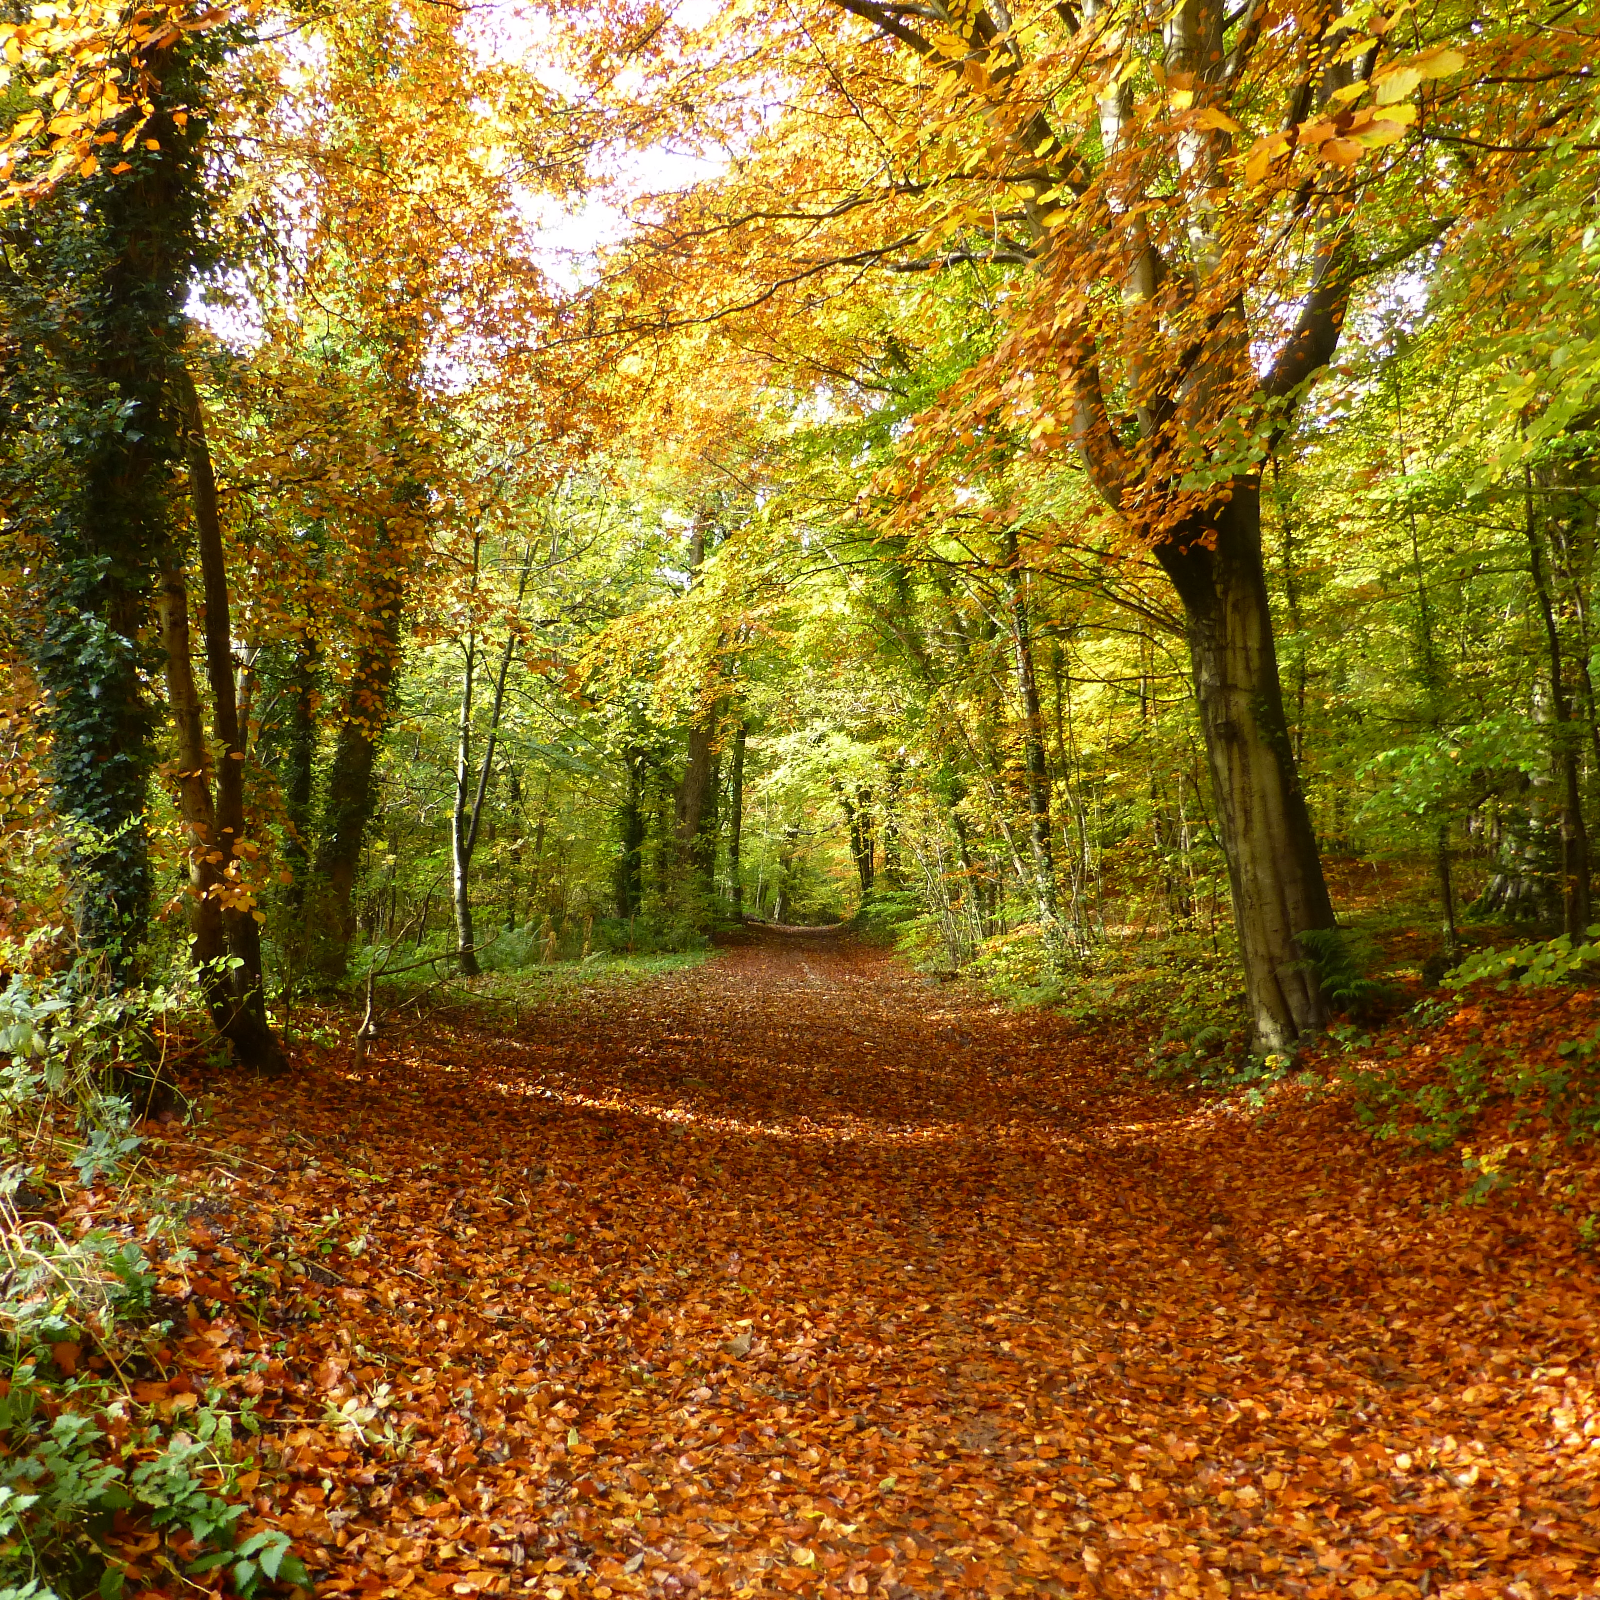

Slide 7
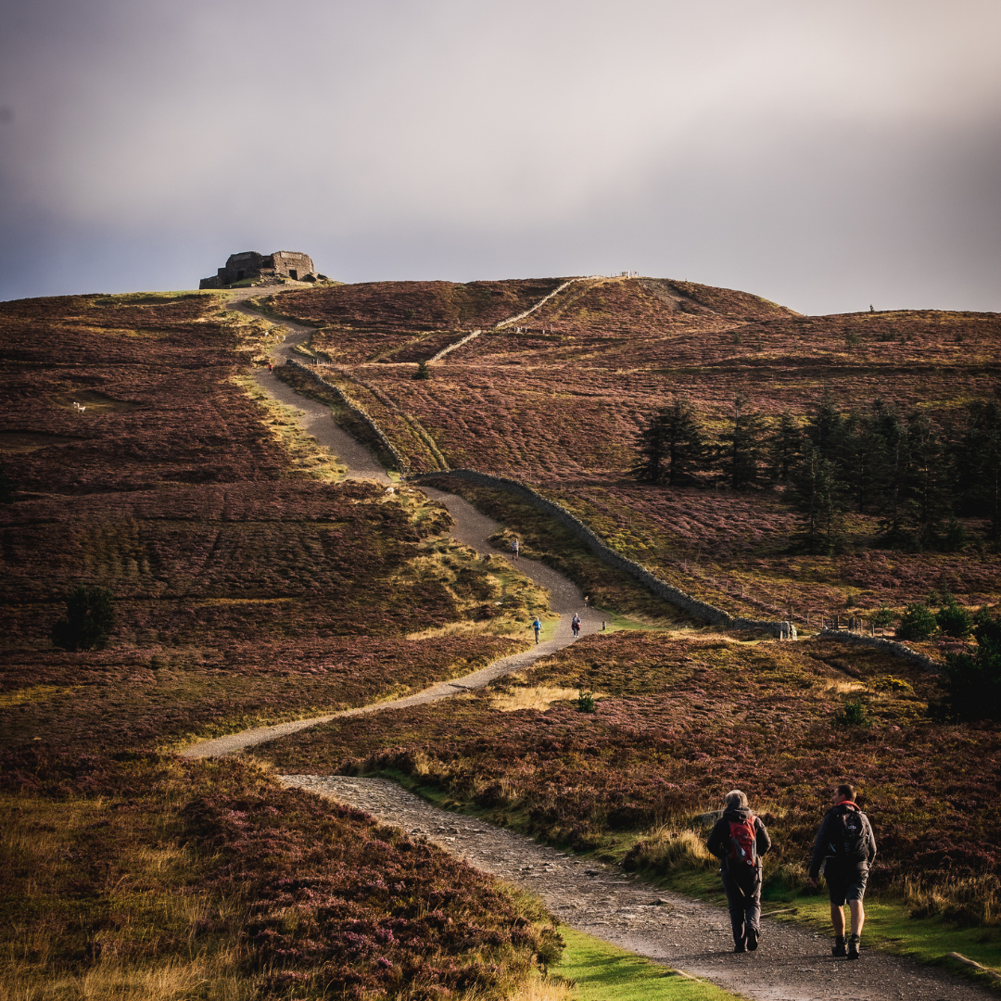
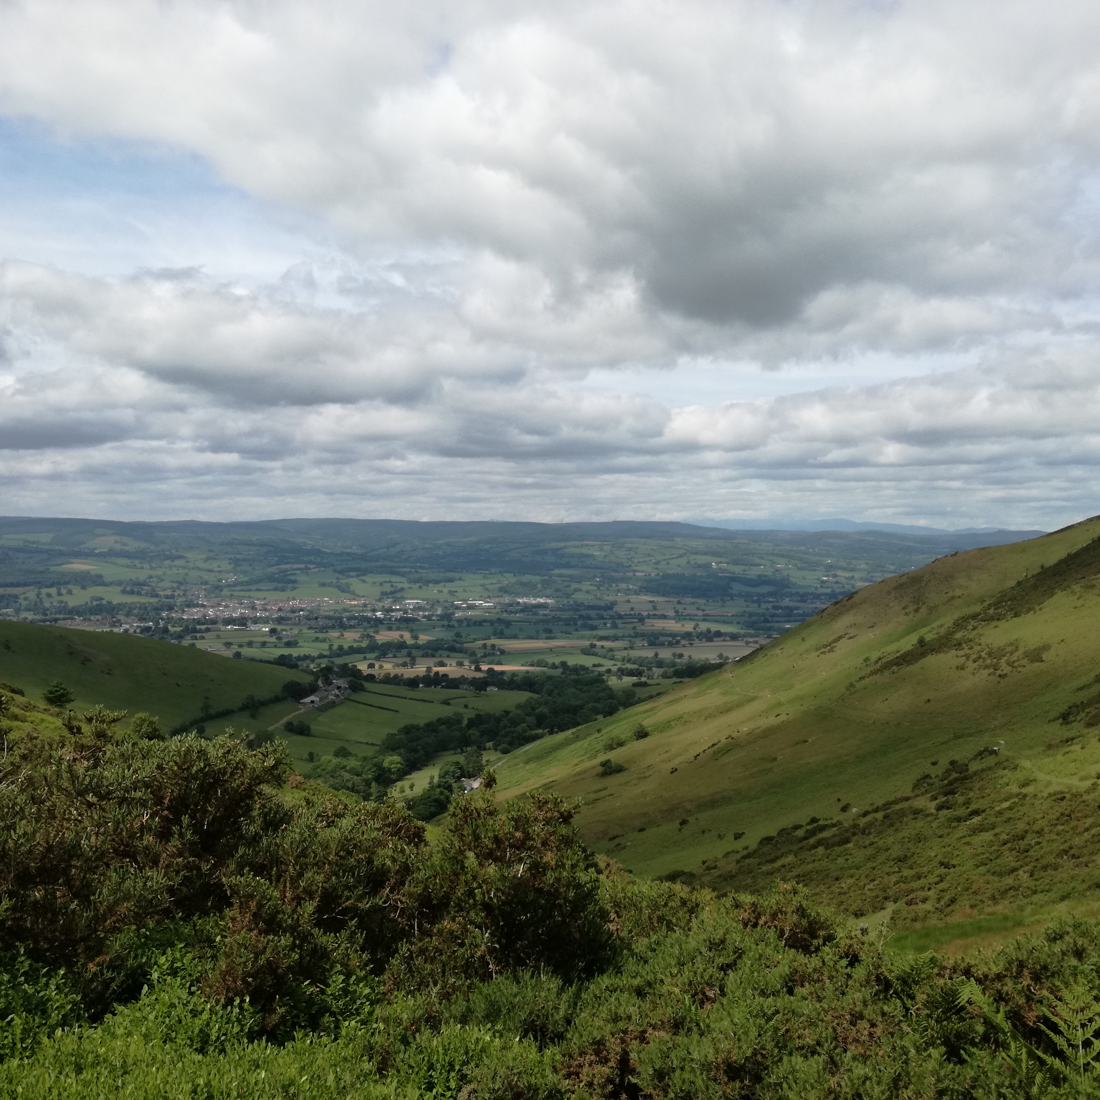

Slide 8
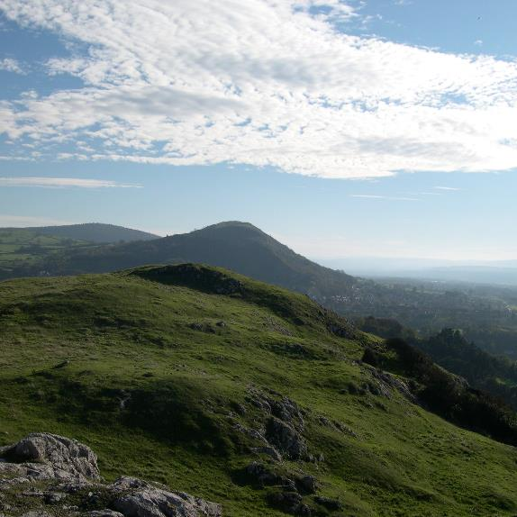
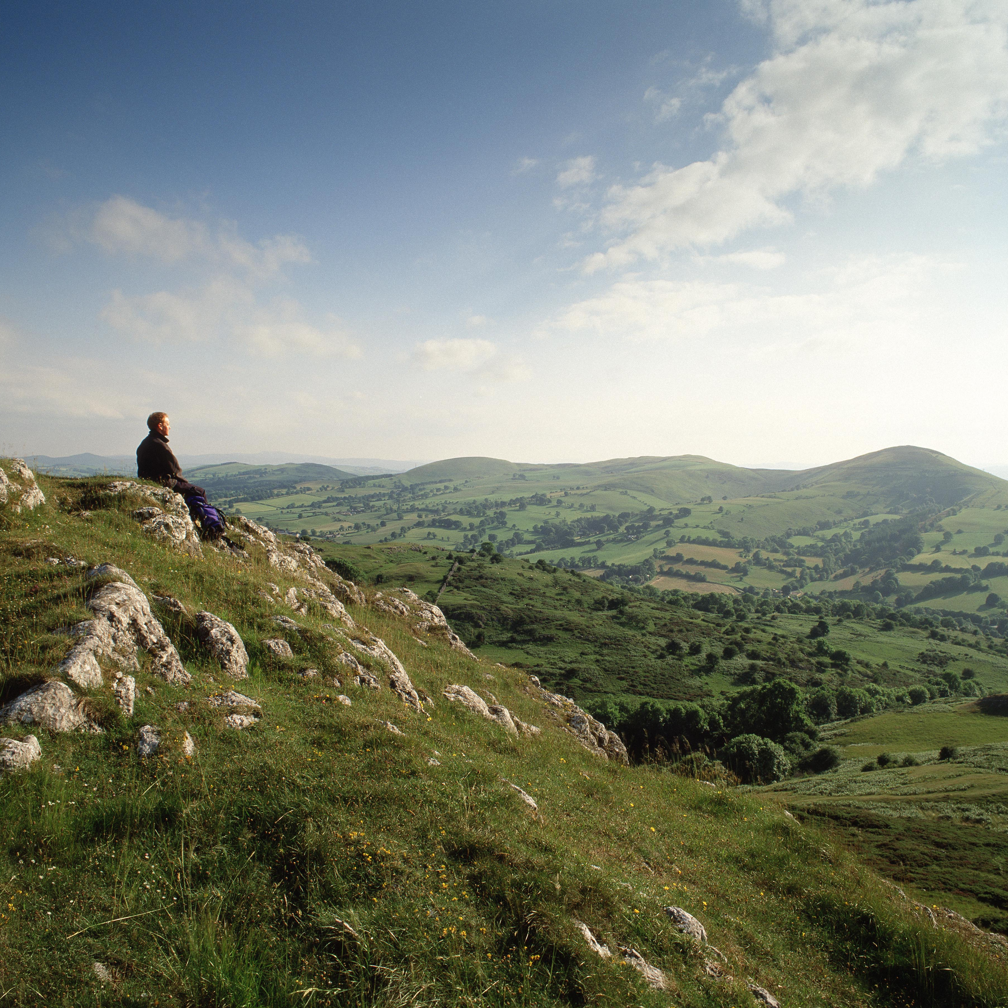

Slide 9
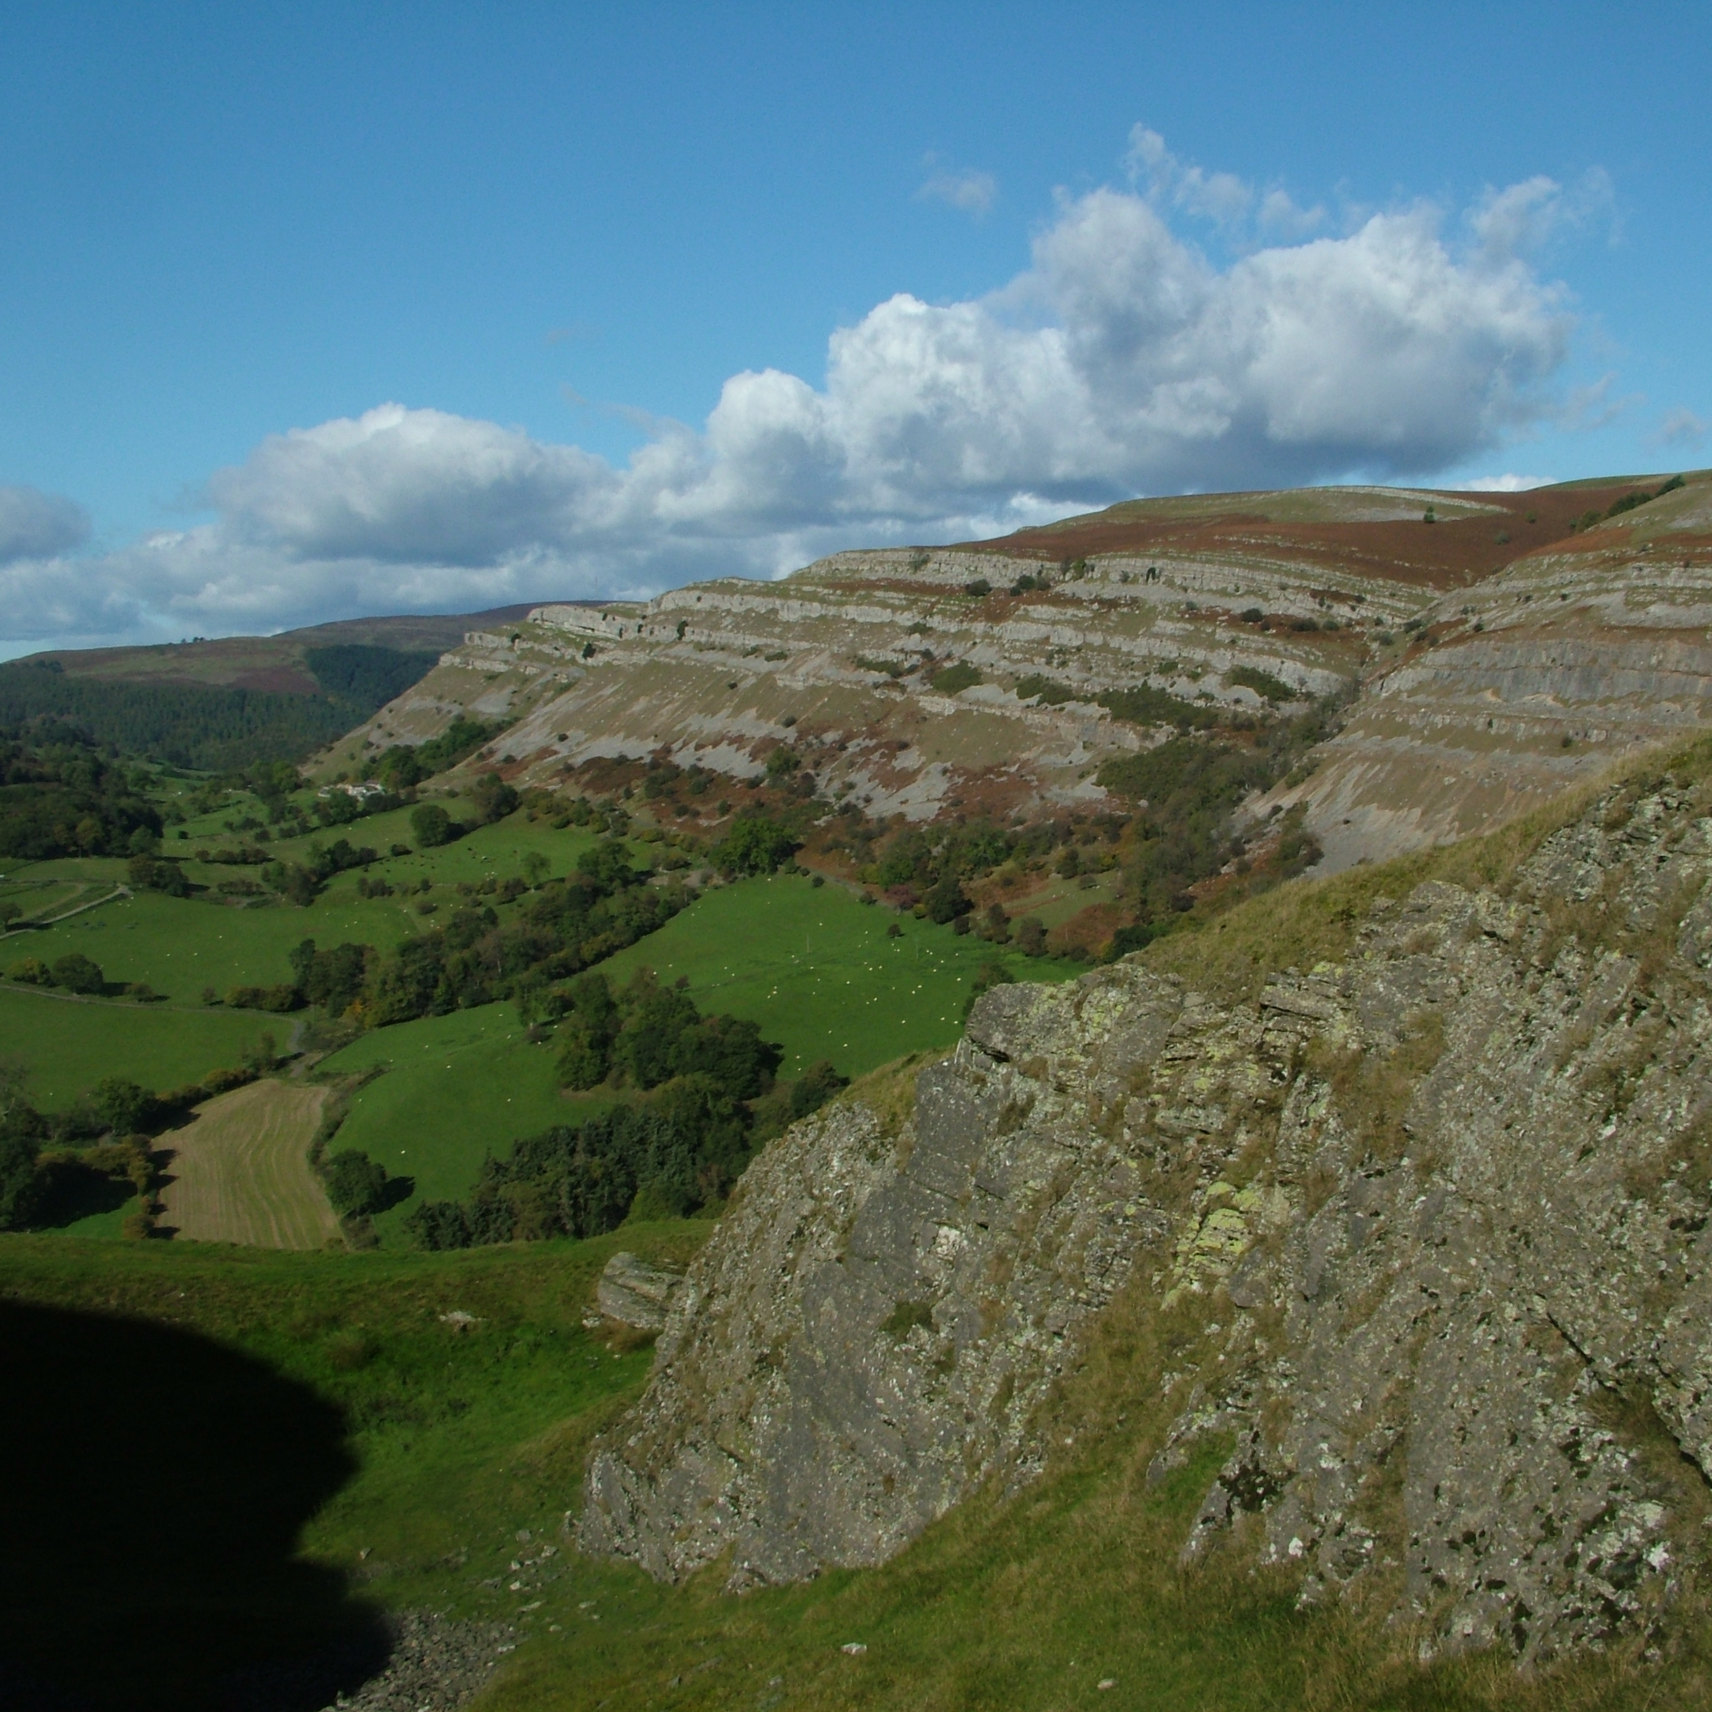

Slide 10
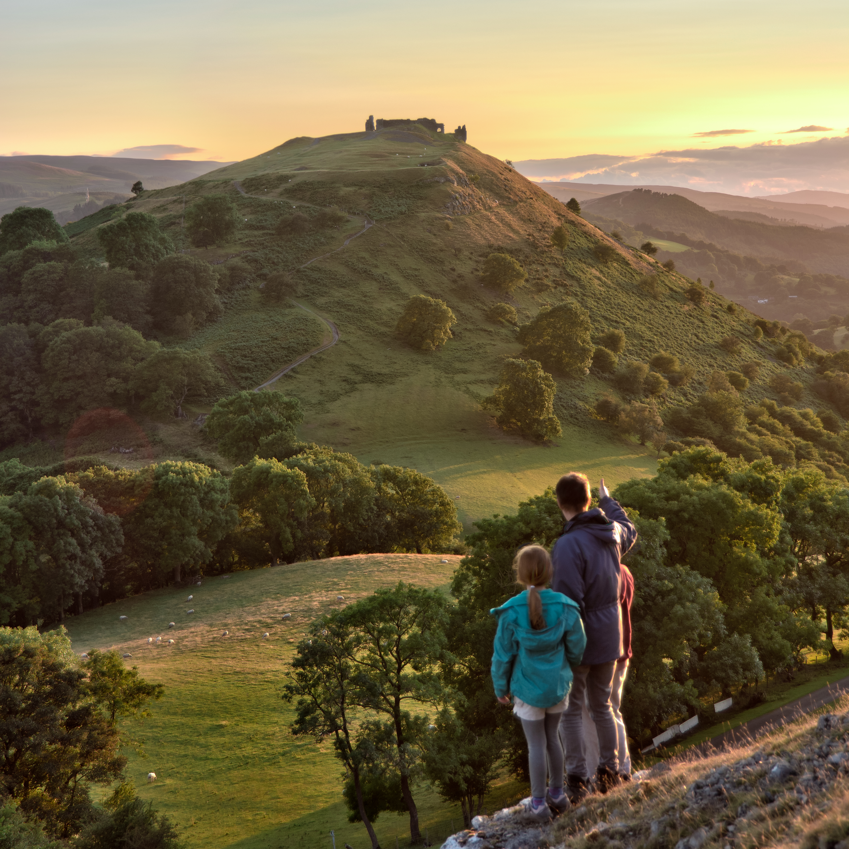
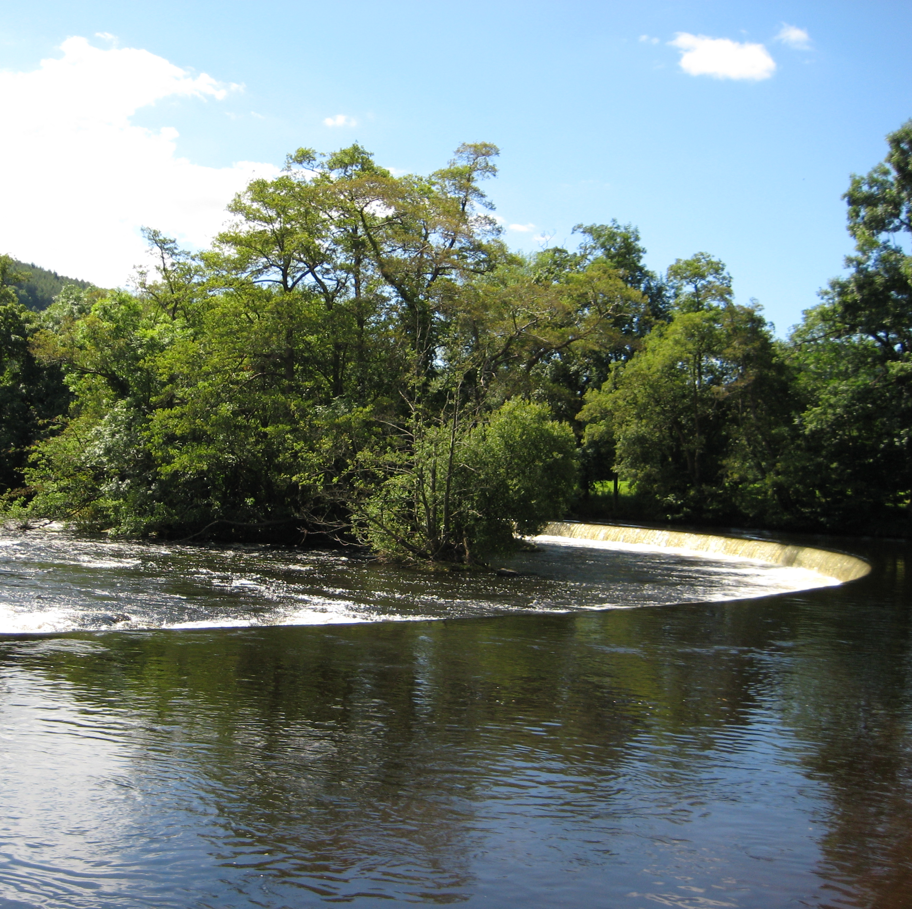

Slide 11
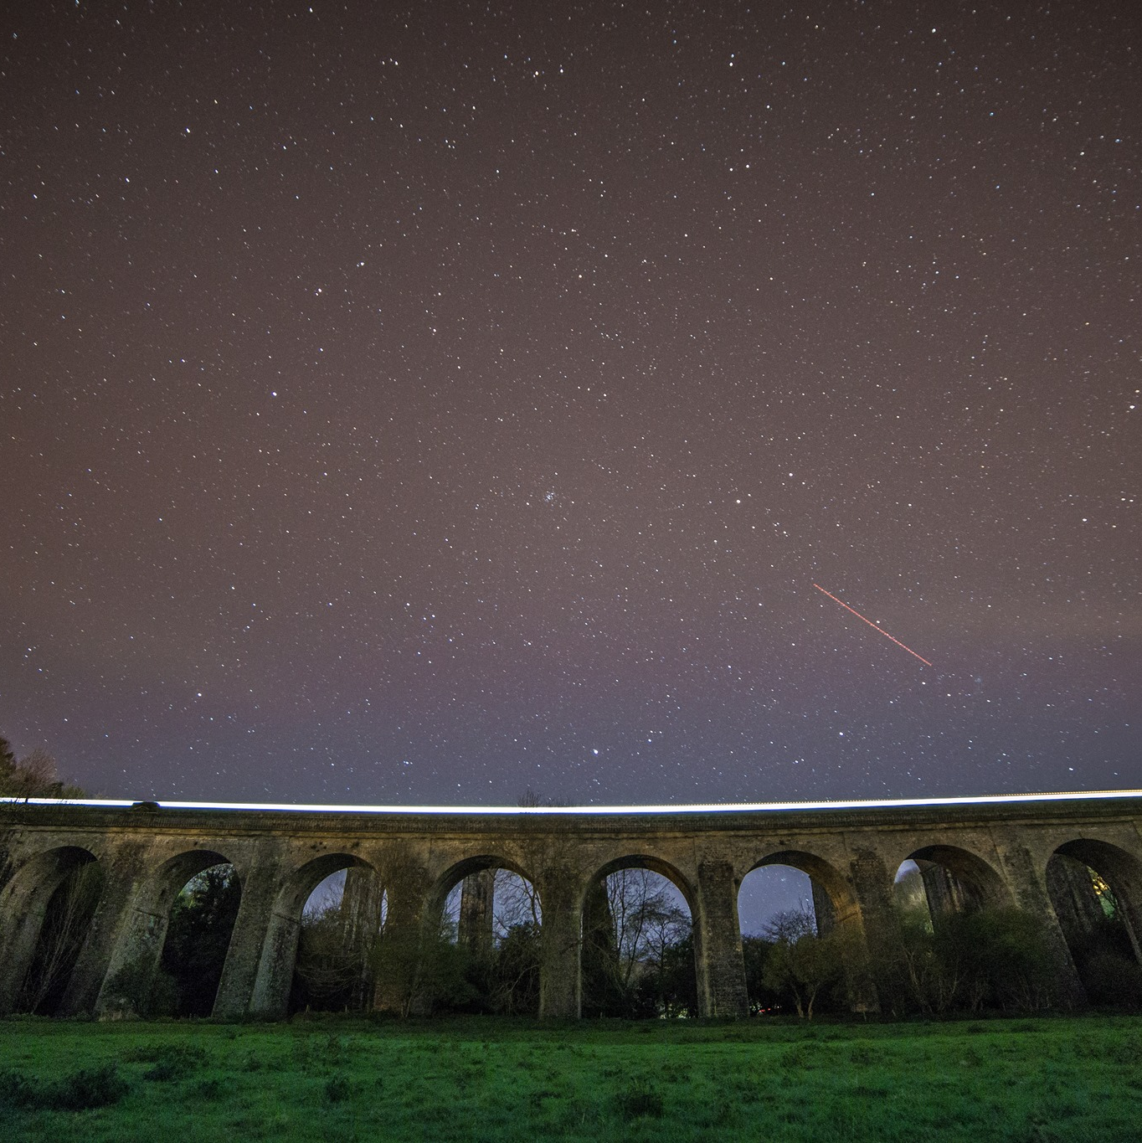
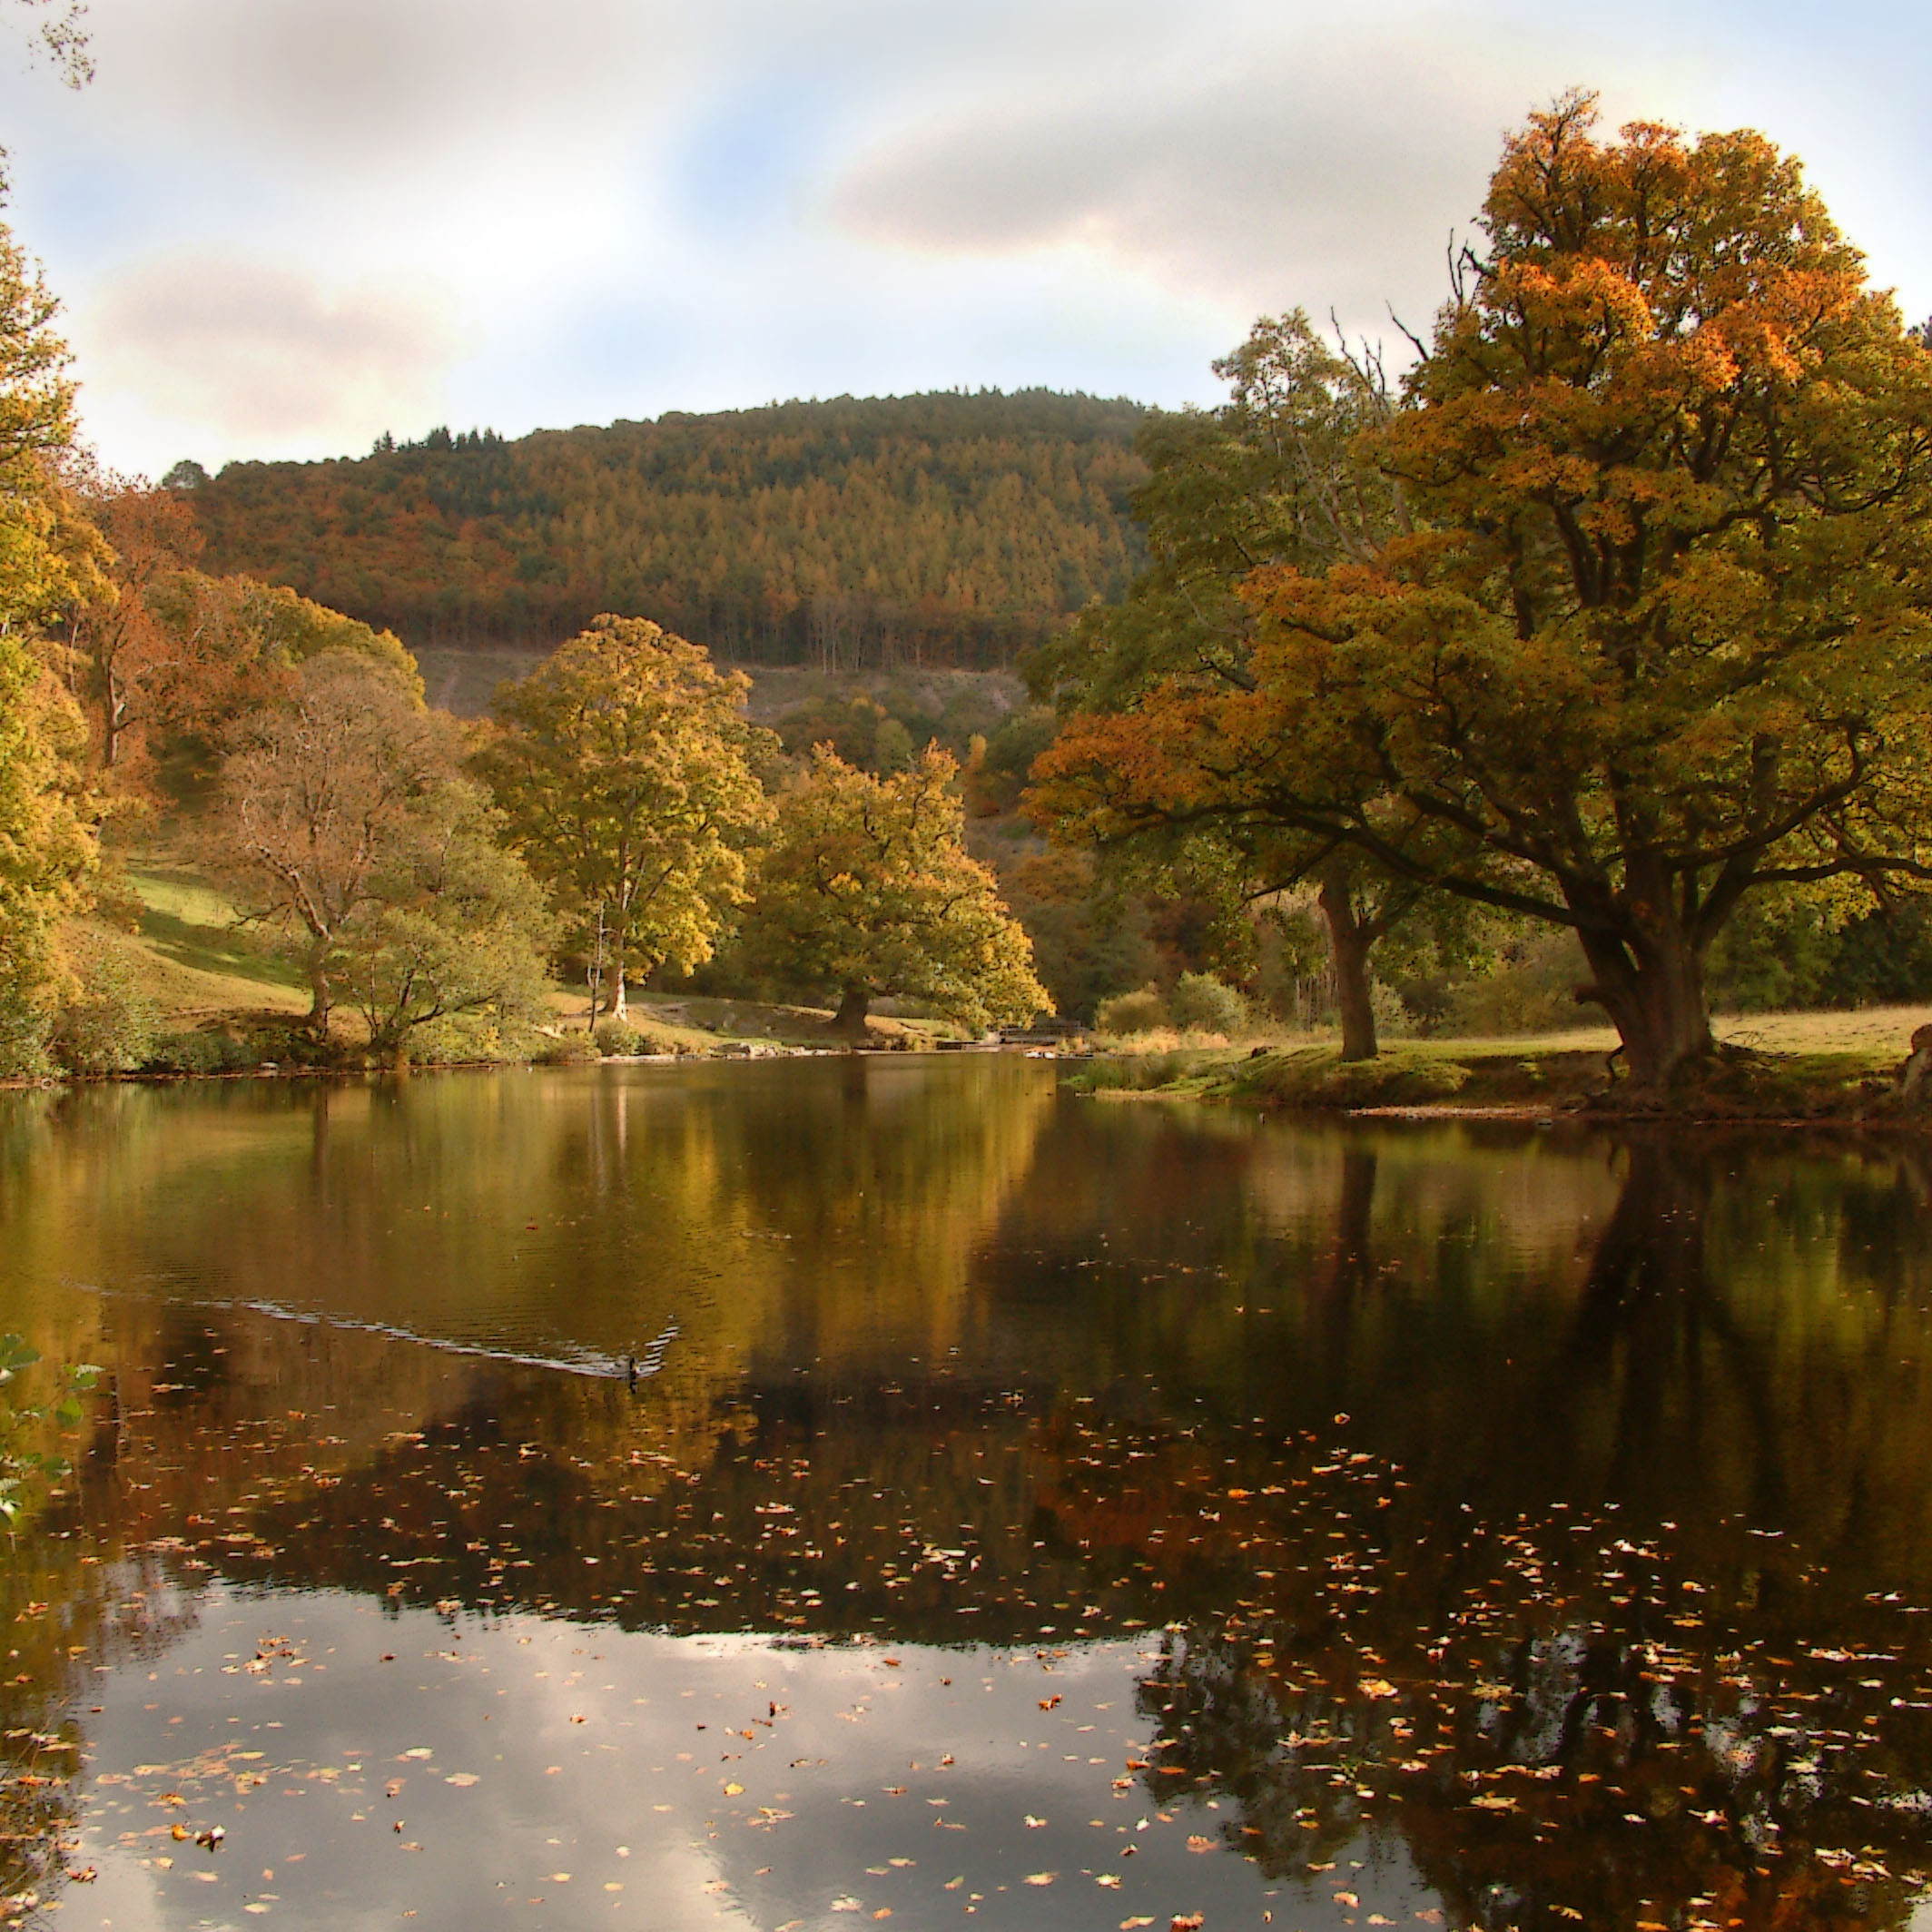

Slide 12
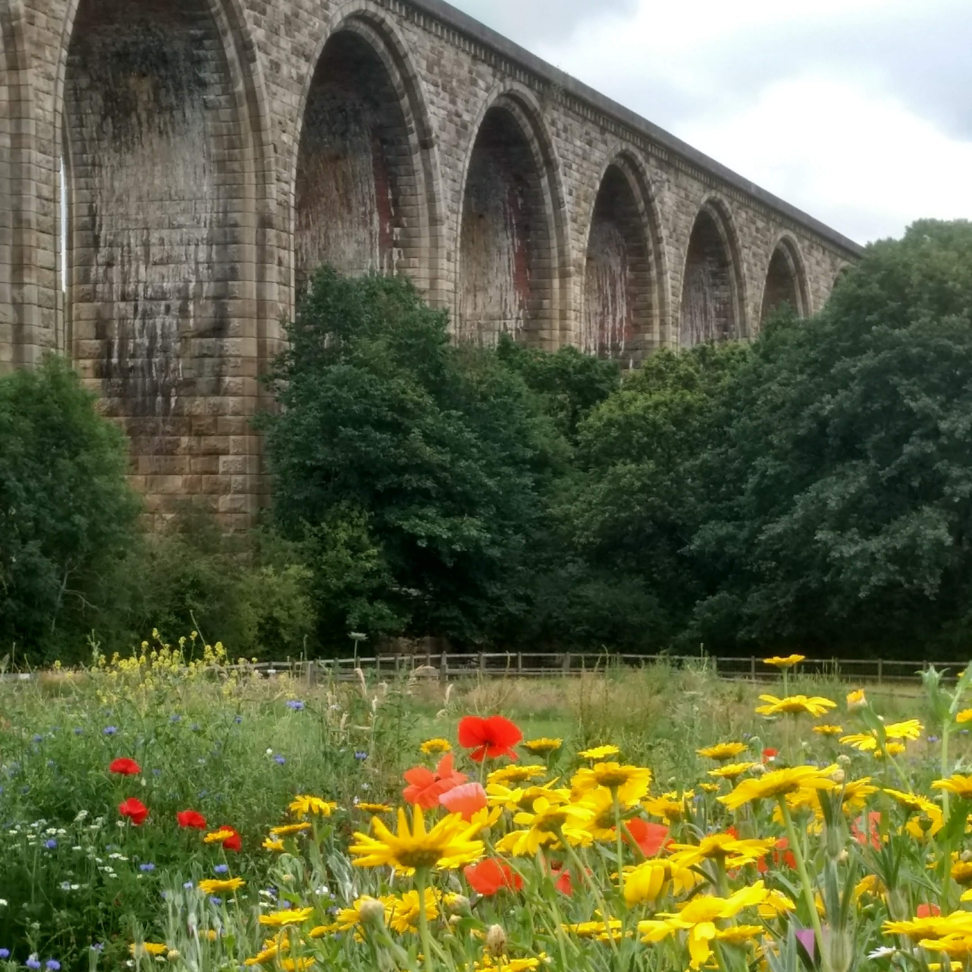
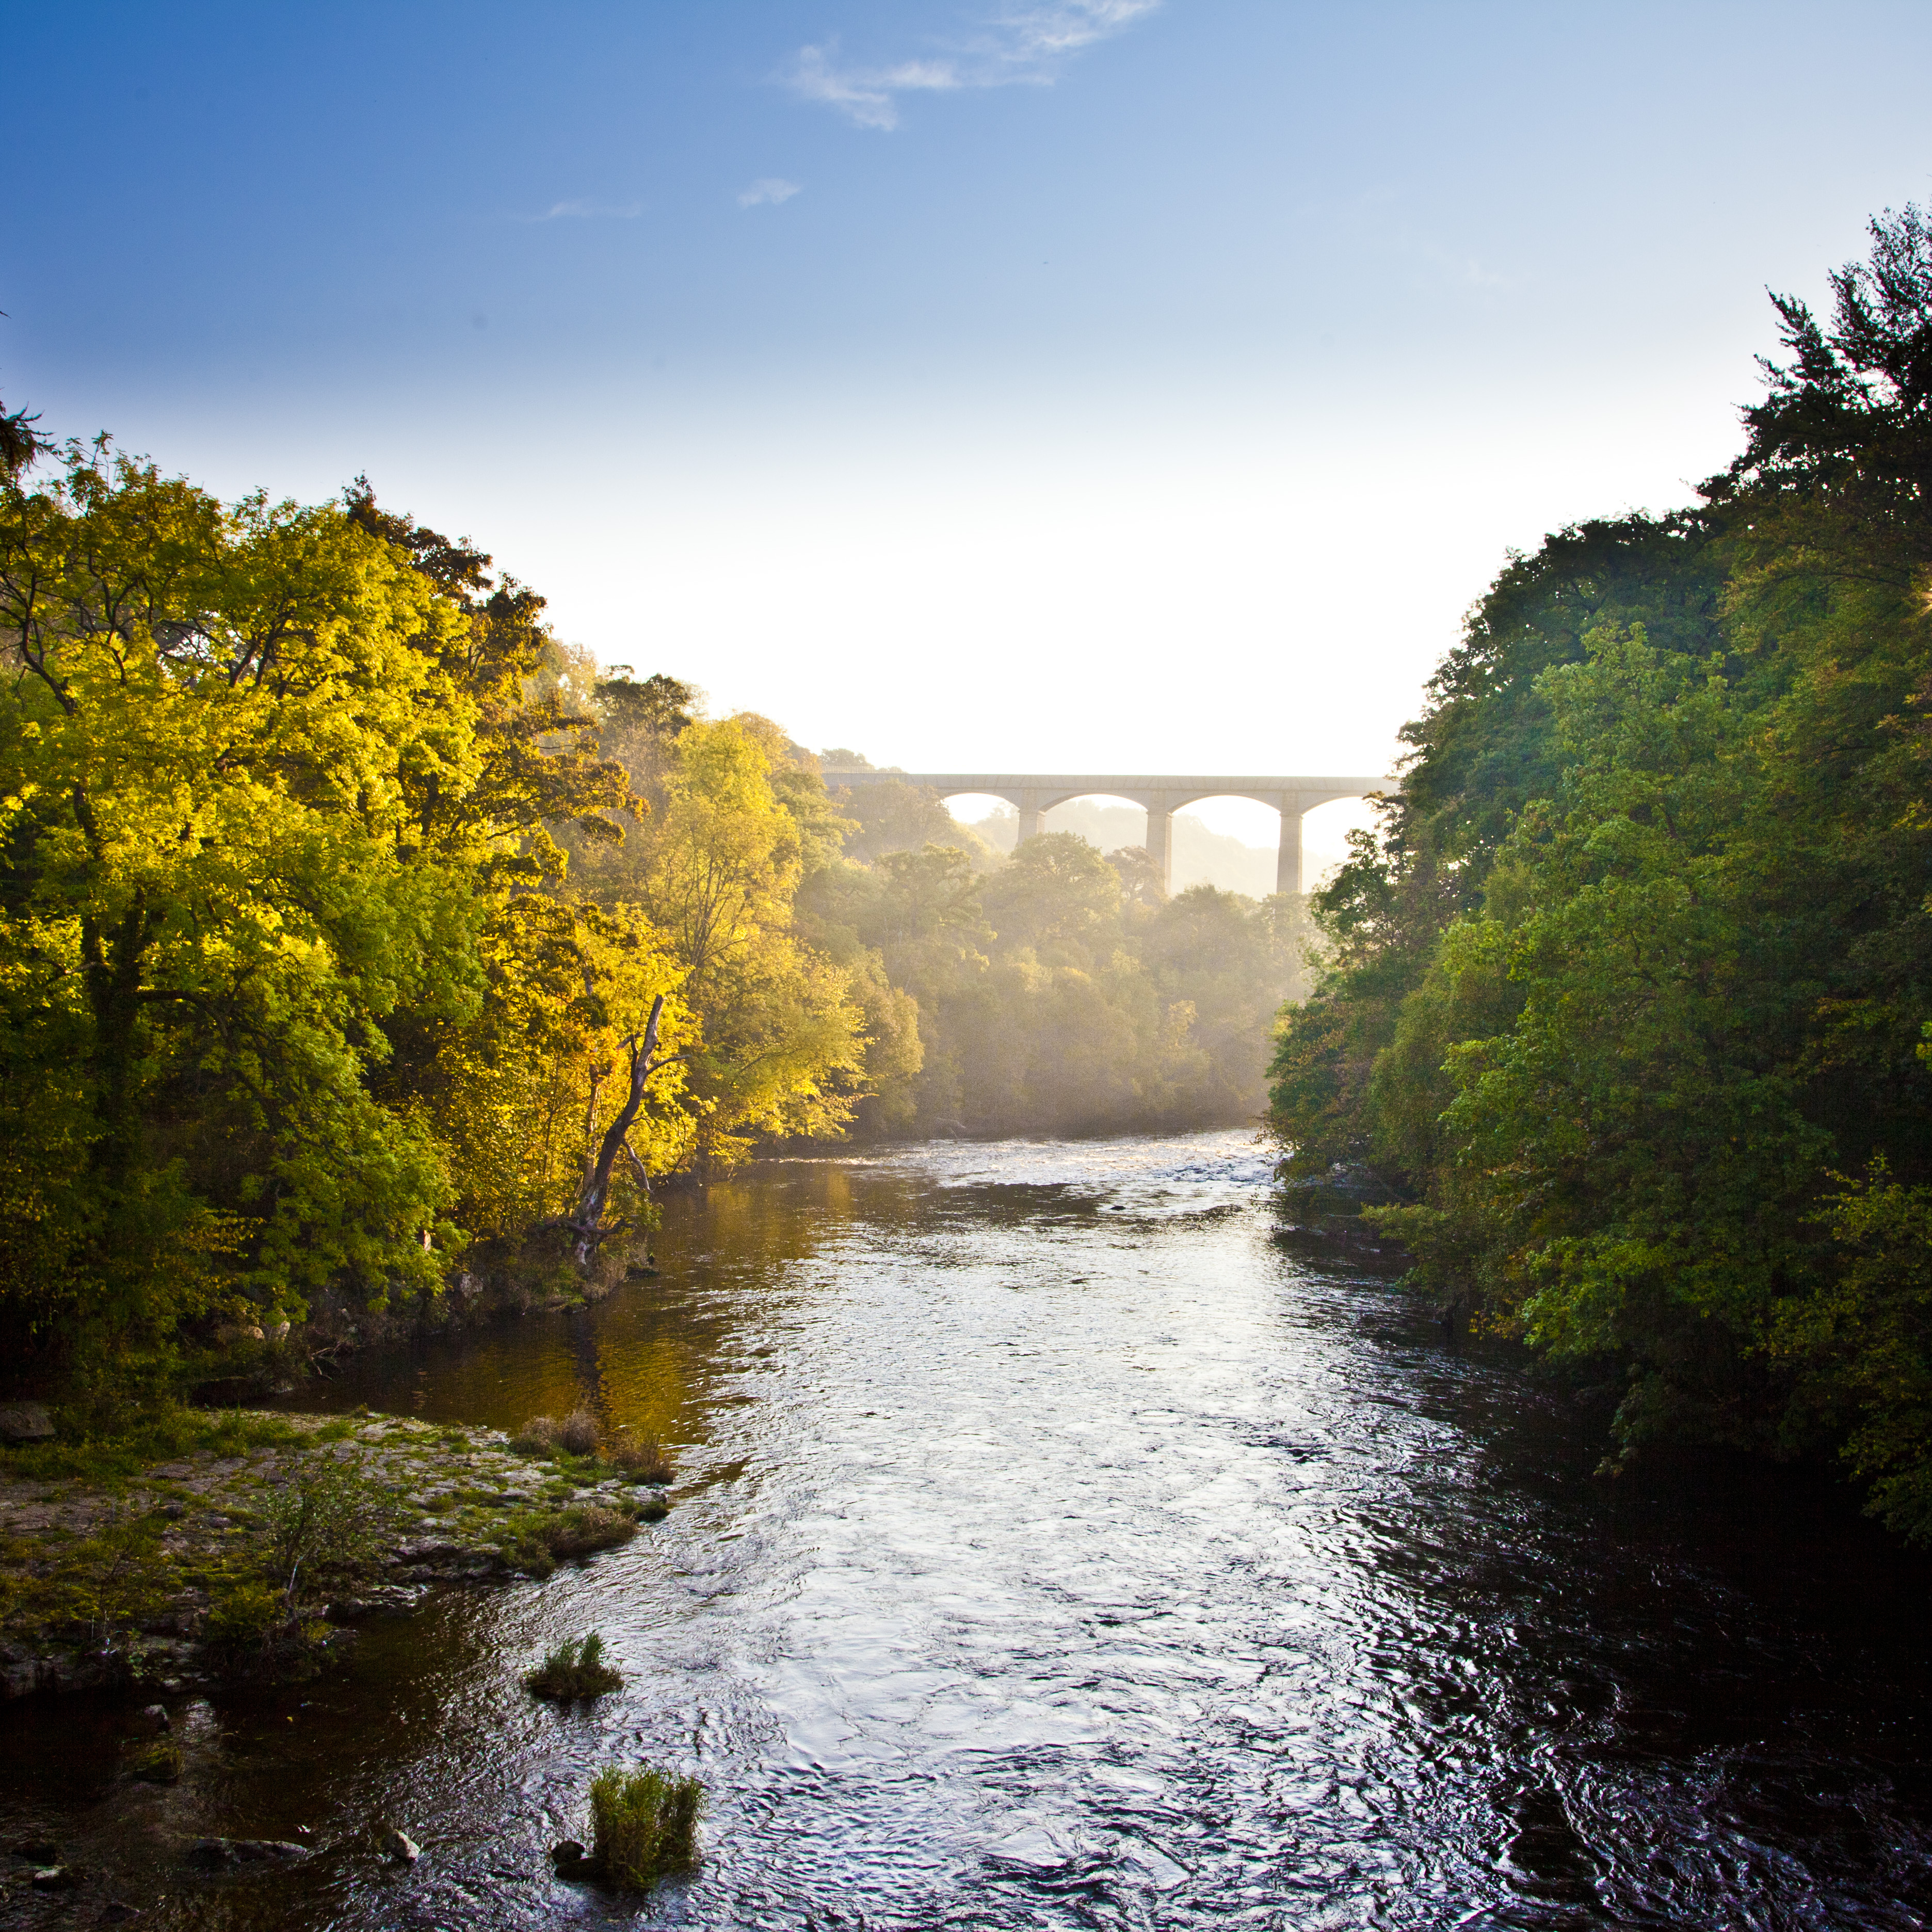

Slide 13
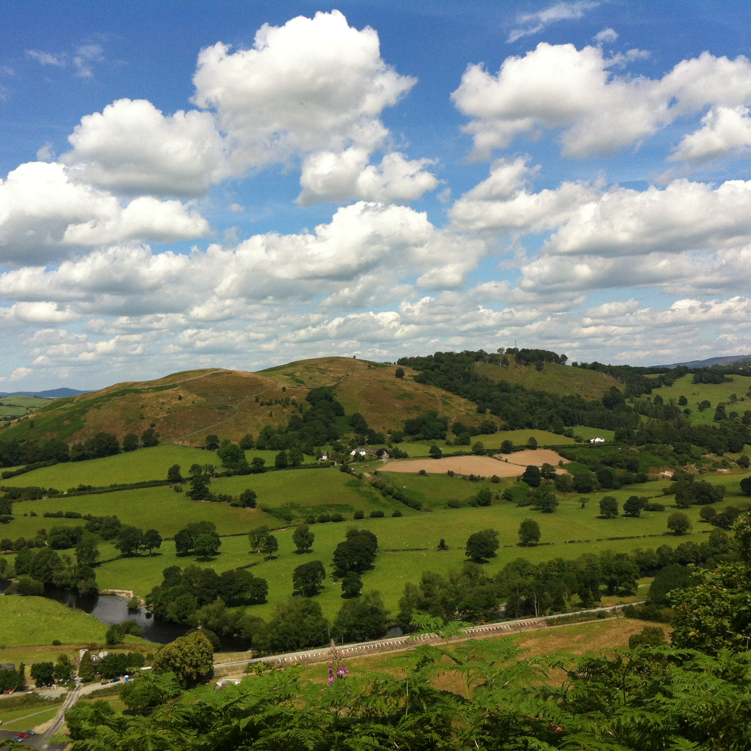
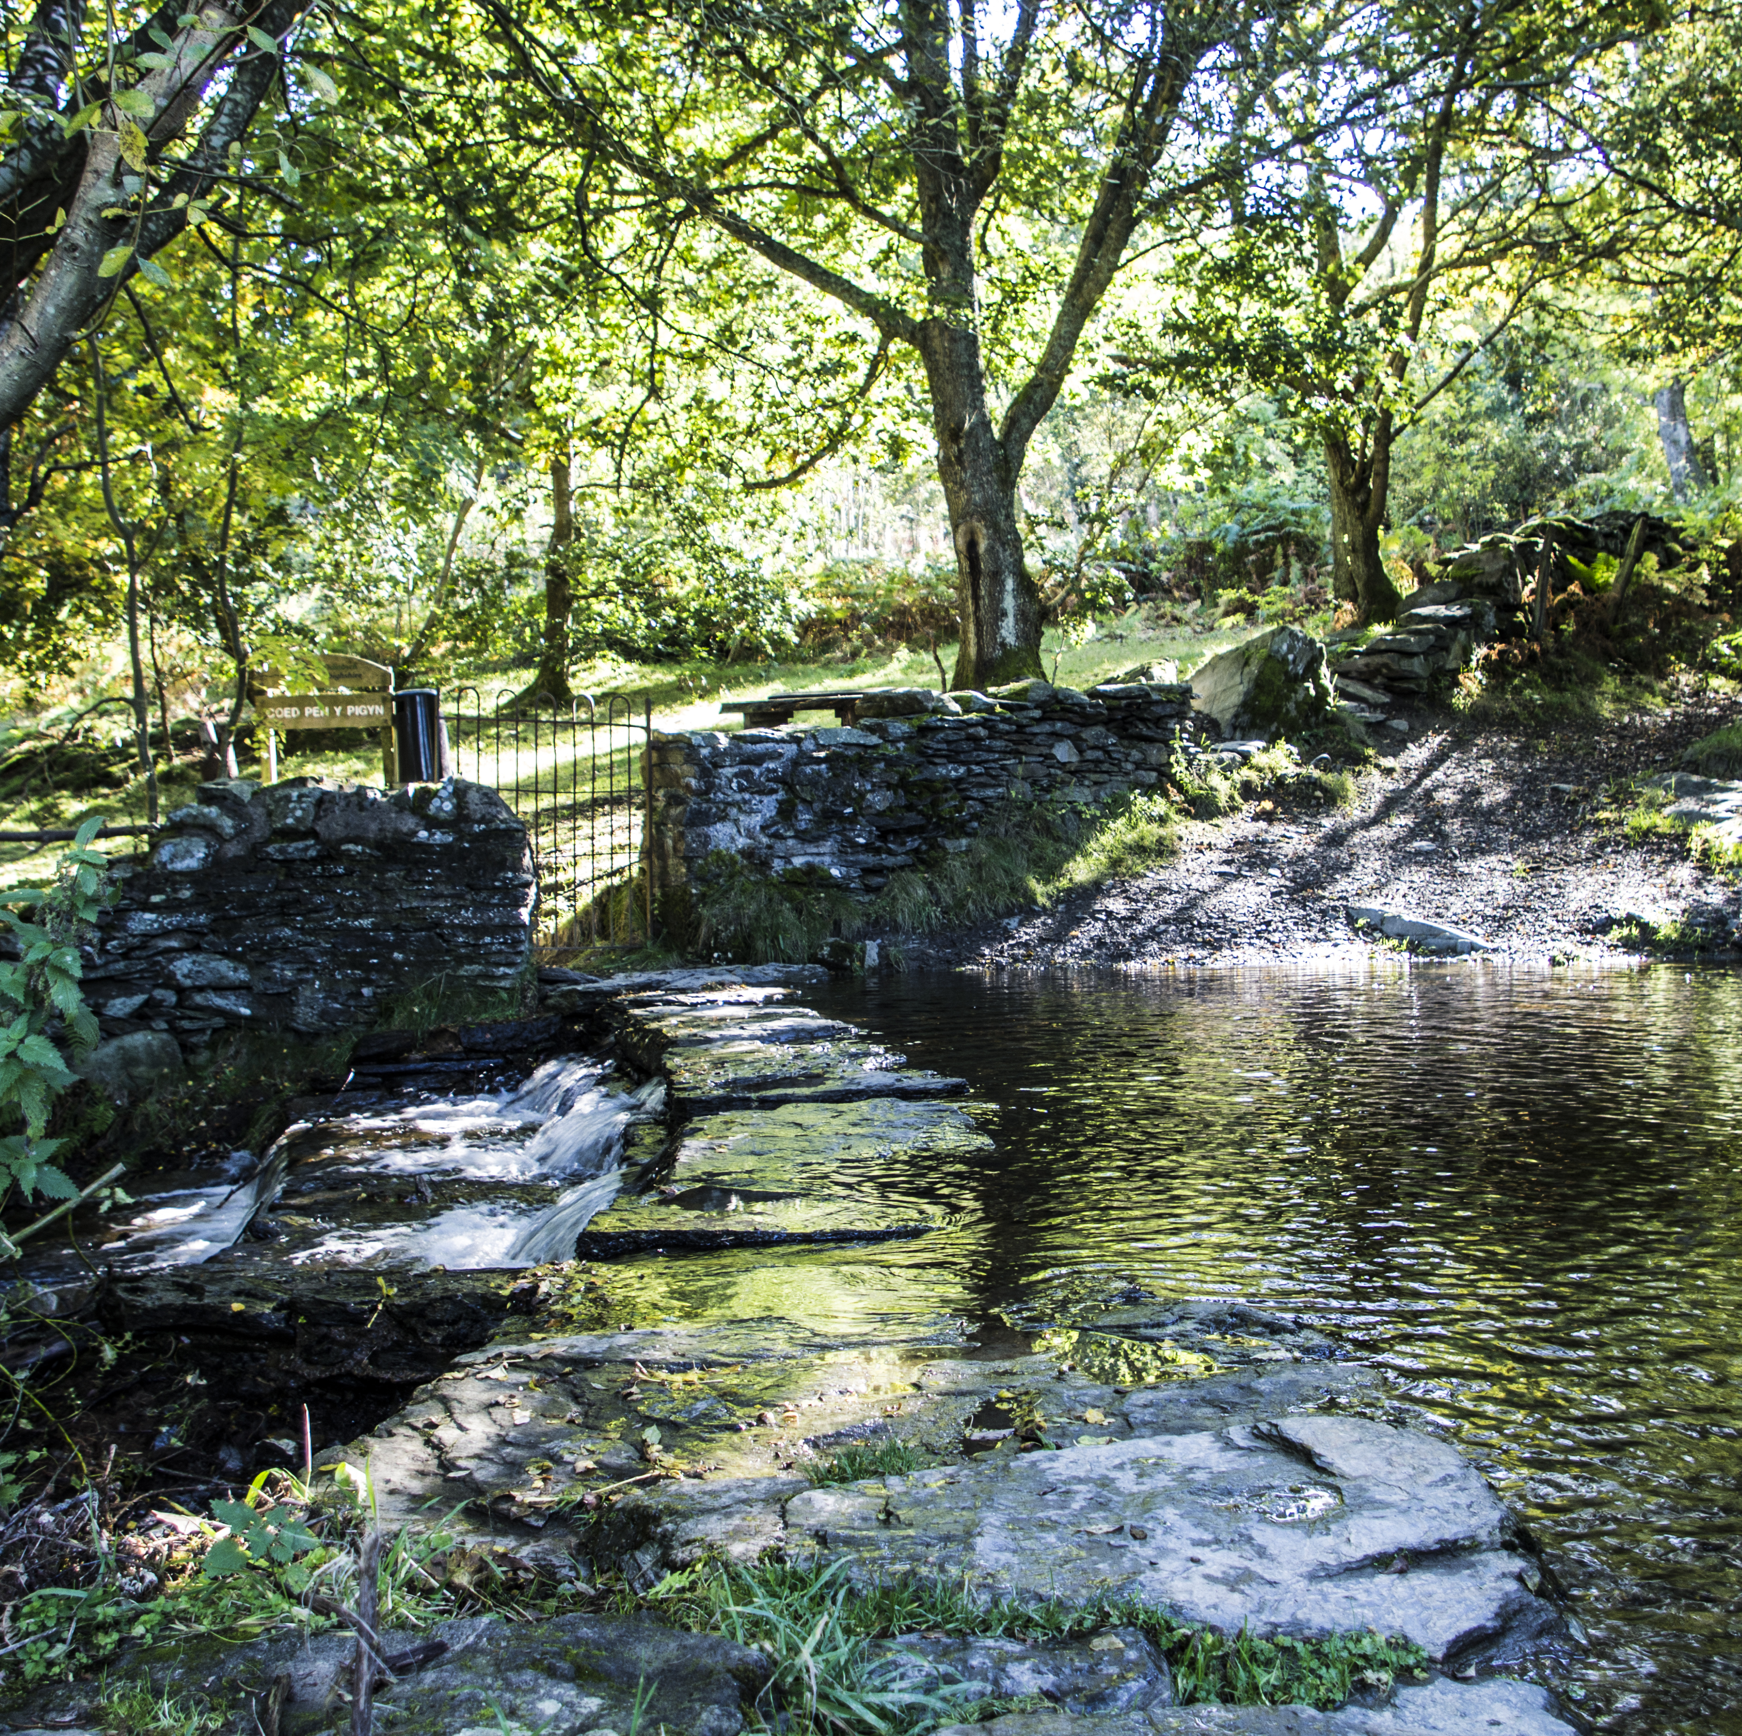

Slide 14


If you come across a new word or place, use a search engine to research the definition or location.
Discuss your ideas, you will find some are more difficult to decide on than others, so choose the one that most people agree on.
Activity 1: Discussion
As a class or in pairs, look at the table listing features that can be found in the Clwydian Range and Dee Valley National Landscape.
Navigate through each word and decide which of the four categories the special quality or feature should be placed into.

Slide 15
The special qualities and features of our National Landscape can be sorted into these categories:
Natural Beauty
Outstanding scenery and landscape features that have occurred naturally
Biodiversity
Rich and varied plant and
animal life
Heritage
Archaeological remains and places, events and people of historical importance
Culture
People living and working in communities with strong local traditions and distinctive
ways of life

Slide 16
Special Qualities and features you will find in the Clwydian Range and Dee Valley
Hillfort | Hiker | Canal | Orchid | Dark skies | Plas Newydd historic house
Pen-y-Pigyn | Horseshoe Falls | Belted Galloway cattle | Chirk Viaduct | Dinas Bran Castle | Coppicing
Drystone wall | Ancient trees | Horse-drawn boat | Meadow | Quarry | Curlew
River Dee | Dormouse | Mountain biker | Mountain | Llantysilio Church | Lesser horseshoe bat
Archaeology | Canoeist | Pontcysyllte Aqueduct | Shepherd and sheepdog | Offa’s Dyke | Community Shop
Heritage railway | Woodland | Butterfly | Ranger | International Eisteddfod | Heather
Bluebells | Valle Crucis Abbey | Valley | Hedgerows | Wetlands | Black Grouse
Sustainable Tourism | Moorland | Chirk Aqueduct | Limestone cliffs | Lime kilns | Moel Famau

Slide 17
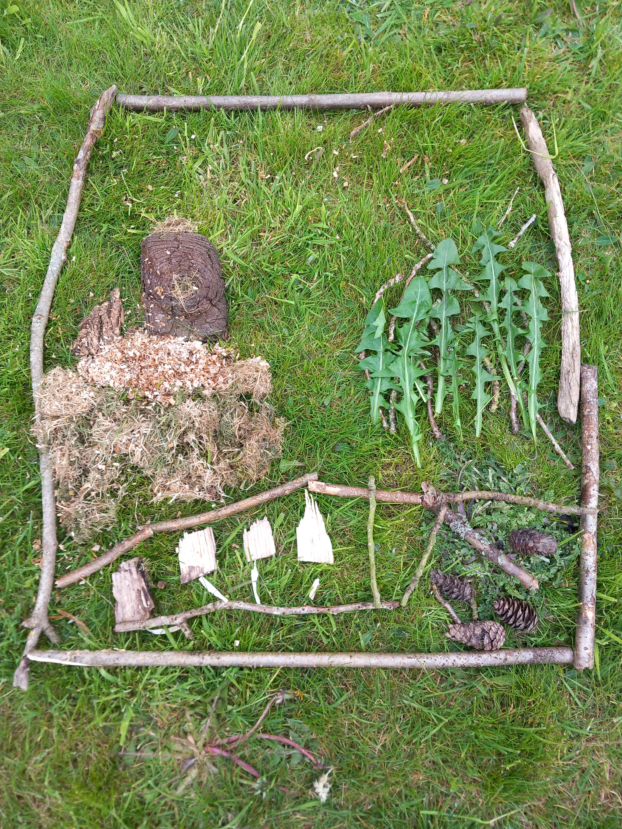
You will need:
Outdoor space
Range of natural materials (e.g. fallen leaves, twigs, petals, stones, soil).
Activity 2: Create a Landscape
As individuals or in pairs create your own special landscape using natural materials to represent the special features, places and qualities.
Once complete, take turns to be a tour guide and show your landscape to
another person or pair.
Reflection activity - do you have an outdoor place that is special to you?
If so, what makes it special?

Slide 18
Activity 3:
Landscapes under pressure
You will need:
Interactive whiteboard
A3 paper
Pencils and crayons
Printed landscape pressures images
Scissors
Let’s find out about some of the problems and pressures faced by National Landscapes.

Slide 19
Instructions – Landscapes under pressure
First in pairs, take it in turns to sketch a special landscape onto the paper, by following each other’s instructions.
Don’t forget to include roads, buildings and wildlife species and think about the special qualities too.
Example:
Instructor -
“Draw a river across the bottom of the paper.”
Swap over
New instructor -
“Draw rolling hills at the top of the paper”
Swap over
First instructor -
“Draw a ruined castle on a hill top with a winding path”
Swap over
Second instructor -
“Draw a woodland on the left hand side of the paper above the river”
Next cut out the pictures from the Landscape Pressures image resource slide.
Then using the next slide, as a whole class explore the scenarios of pressures on the landscape. Your teacher will ask you to temporarily place the cut out images onto your landscape picture as you discuss each one.

Slide 20
Instructions – Landscapes under pressure
“Use the car image to show a car park/road on your picture. This represents a ‘honey pot' area where lots of people want to go to.”
What do you think happens in the car parks and on the roads in these areas?
“Now put some walking boots onto your picture.”
What happens to the paths when lots of people walk there?
“Now add the running dog, cow and sheep.”
What happens in the farmland and in special areas of conservation if dogs are allowed to run free?
“Add the canoe to the river if you have one.”
What happens if lots of canoeists enter the river from the natural bank in one space?
“Add the disposable BBQ.”
What happens if people have BBQs in wild areas?
“If you have a moorland habitat, add the fire.”
What happens if a moorland fire is at the wrong time of year or gets out of control?
“Now add the bike to your picture.”
What happens if mountain or motor bikes use the special areas of conservation?
“If you have buildings, add the outside lights.”
What happens to wildlife if there is a lot of artificial lighting at night?
“Add the tractor and mower if you have grassland.”
What happens if a nesting site for curlew gets cut before the chicks have fledged?

Slide 21











Landscape Pressures - Image Resource

Slide 22
To find out more about the people who work in the Dee Valley in both the past and present day, play the Top Trumps
game and explore the job roles in the Dee Valley people Fact files.
Extension Activity:
Landscapes Under Pressure
All these scenarios are some of the problems that countryside rangers and farmers have to face at different times throughout the year. How could we reduce these problems or what could we do instead?
In groups make a mind map to help you plan some solutions. Share your ideas with the rest of the class.
Notes:
Hints: educate others to make sensible choices and about the wildlife, use motion sensor and wildlife friendly lighting, provide areas or opportunities for sustainable recreation, keep dogs on leads in wild areas, encourage people to visit less popular/well known places instead of busy ones, volunteer, raise money to repair paths and other facilities.
Note to teachers; Natural Resources Wales offer a subsidised teaching training day on the topic of “Protect or develop a landscape area” which would support this topic theme. Read here about one teacher’s experience with her class after attending the training: https://naturalresources.wales/about-us/news-and-blogs/blogs/a-teacher-s-perspective-putting-nrw-s-educator-training-into-practice/?lang=en&utm_medium=email&utm_source=govdelivery

